Slide 1
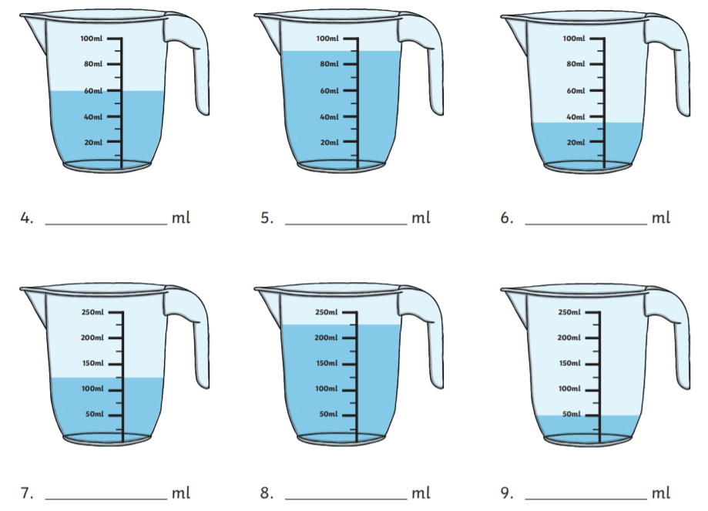
L2 – Independent task – What is capacity and identifying capacity.
What is capacity?
Write down what is capacity.
Write down the measurements of each jug in the space below the image.

