Slide 1
PSHE and Citizenship
Relationships | VIPs
PSHE and Citizenship | Year 4 | Relationships | VIPs | Is This a Good Friend? | Lesson 3

Slide 3
Aim
I can identify my own support network.
Success Criteria
I can identify healthy and unhealthy behaviours from friends.
I can reflect on the times I would need to access support.
This resource is fully in line with the Learning Outcomes and Core Themes outlined in the PSHE Association’s Programme of Study.

Slide 4
The Big Questions

Slide 5
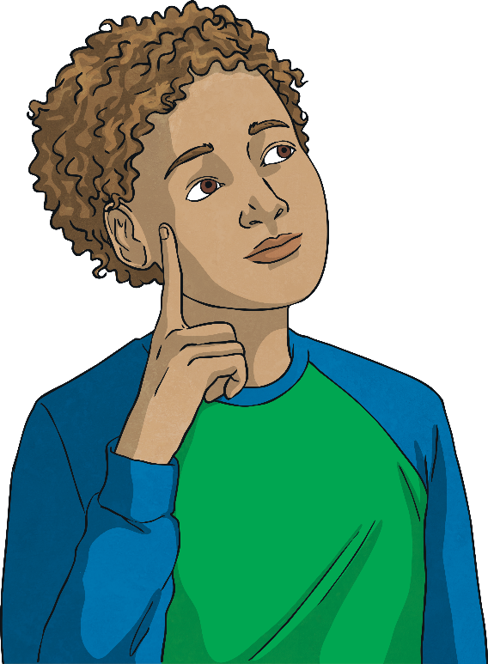
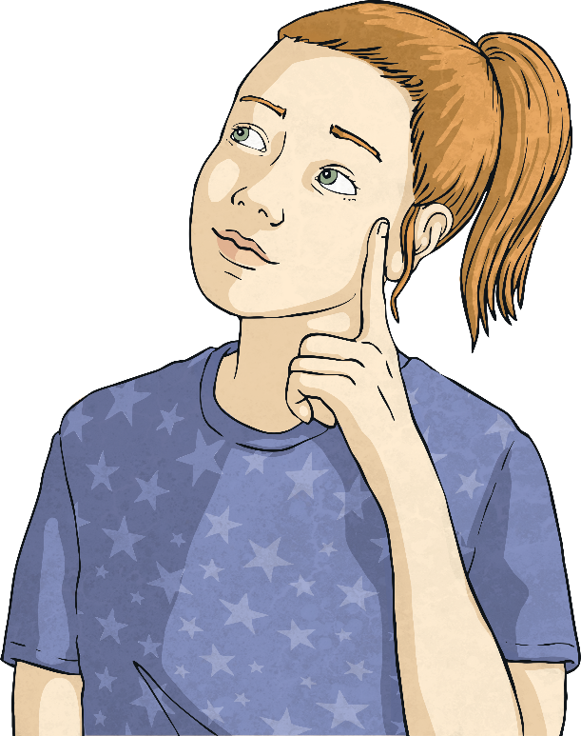
What makes a good friend?
What can we do if someone is not a good friend?
Write your answers to the Big Questions on sticky notes and then stick your answers on the Big Questions Poster.

Slide 6
Reconnecting

Slide 7
Ourselves
How can we ensure that we are a good friend to others and that they are good friends to us?
involve our support network if our friendship needs support
have self-respect to ensure we are treated how we treat others
be fair
say what we are thinking
listen to our friends
be honest

Slide 8
Exploring

Slide 9
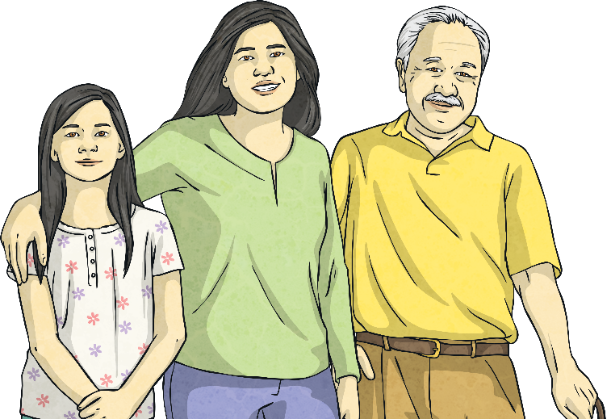
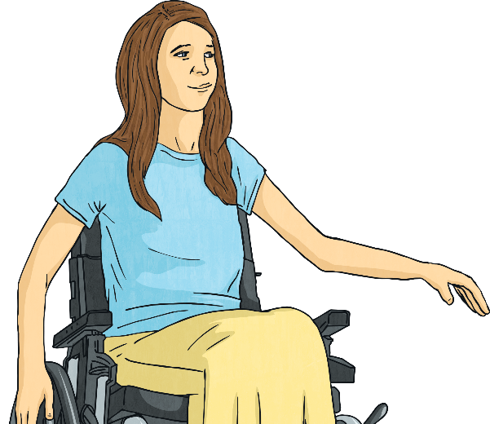
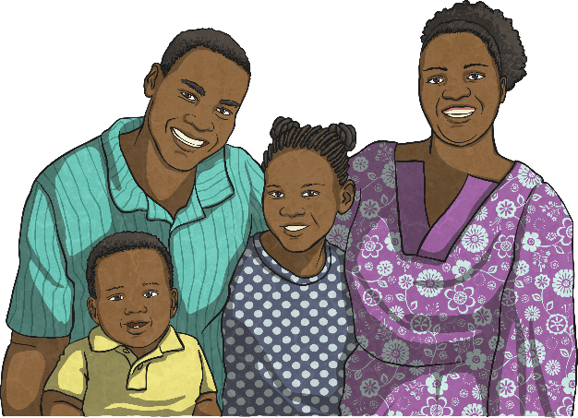
Relationship Map
In our lives, we all have different important relationships. These are very important people (VIPs) in our lives.
These people might be family members, friends or other adults we know and trust, like our teachers.
These people are those we can turn to for help if we need to.

Slide 10
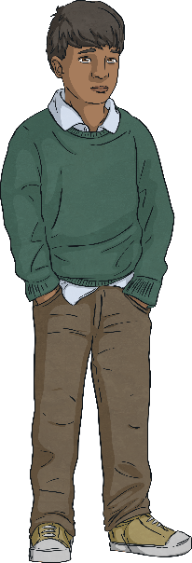
Relationship Map
Here is Pete’s Relationship Map. He is in year 4, just like you.
Acquaintances
children in Pete’s class
teachers
friends of the family
Relatives
grandparents
cousin
aunts and uncles
Family
parents
grandparents
siblings
Friends
friends within school
friends outside of school

Slide 11
Dares
The following story is about something that happened to Pete.
Pete went over to his friends on the school playground and asked what they were playing. His friends whispered to each other and one, Billy, said to Pete, ‘We can’t tell you as you’re not grown up enough to play this game’. Pete felt sad and said, ‘I am grown up enough, please tell me the game’.

Slide 12
Dares
The rest of the friends smiled to each other and said to Pete that they were playing a game called Dares. They told Pete that if he wanted to play with them he had to prove he was grown up enough by doing the first dare. Pete agreed. The group of friends dared Pete to throw a stone at the classroom window. They said that
if he didn’t, he was a chicken and would not be
able to play with them.

Slide 13
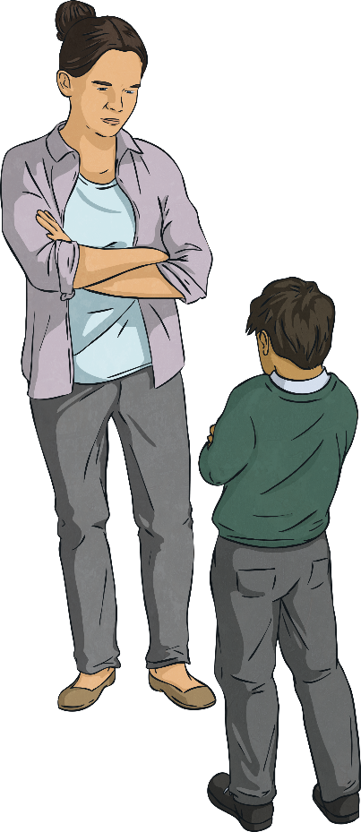
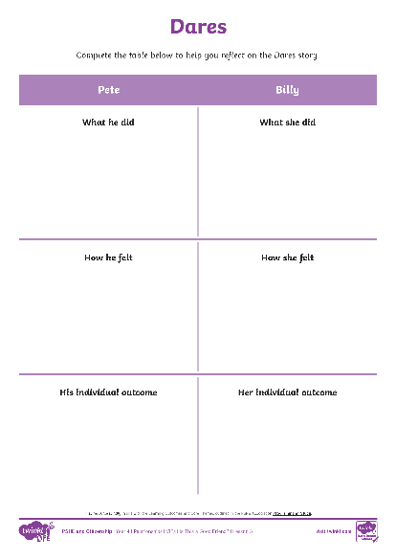
Dares
Pete agreed, because he wanted to be included in the game and threw a stone towards the classroom window. The stone missed the classroom window but hit another child who was in year 3. A teacher came running over and took Pete in to see the headteacher.
In pairs, reflect on the different characters within the story and why they did what they did. Think about how each character felt and what their individual outcome would be.
Consolidating
Reflecting

Slide 14
Consolidating

Slide 15
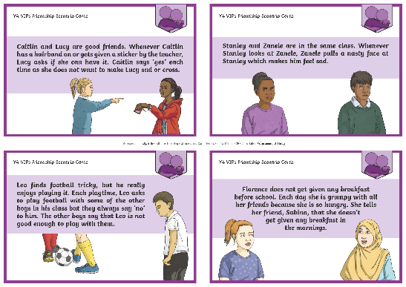
What Should I Do?
Look together at the Friendship Scenario Cards and discuss in pairs what the friends could do in each situation.
Now, as a class we will reflect on all the different ideas we have to resolve the Friendship Scenarios.
Why do we all have different ways to resolve situations?
Are some of the solutions more effective than others?
What should we do if we are unsure what to do in a situation like these?

Slide 16
Reflecting

Slide 17
Support Networks
Support networks are the people around us who are there to help us when we need help; those we can trust, who will look out for us.
Our support networks are made up of our families, relatives, friends and acquaintances. Different situations may mean we need different members of our support network.
If we are having difficulties with our friends then we would need to reach out to our families, relatives or acquaintances.
If we are having difficulties with our family, who could we reach out to for support?
Think about your own support network.

Slide 18
The Big Questions

Slide 19
What makes a good friend?
What can we do if someone is not a good friend?
Do you have any new answers to add to the Big Questions Poster? Write your new answers on a sticky note and add it to the Big Questions Poster.

Slide 20
Aim
I can identify my own support network.
Success Criteria
I can identify healthy and unhealthy behaviours from friends.
I can reflect on the times I would need to access support.

