Slide 1
PSHE and Citizenship
Relationships | Be Yourself
PSHE and Citizenship | Year 1 | Relationships | Be Yourself | Uncomfortable Feelings | Lesson 4

Slide 3
Aim
I can talk about the things that make me feel unhappy or cross and have ideas about what to do when I have these feelings.
Success Criteria
I can identify if a feeling is comfortable or uncomfortable.
I can describe what makes me feel unhappy or cross.
I can think about what I could do to help others if they were feeling unhappy or cross.
This resource is fully in line with the Learning Outcomes and Core Themes outlined in the PSHE Association’s Programme of Study.

Slide 4
The Big Questions

Slide 5
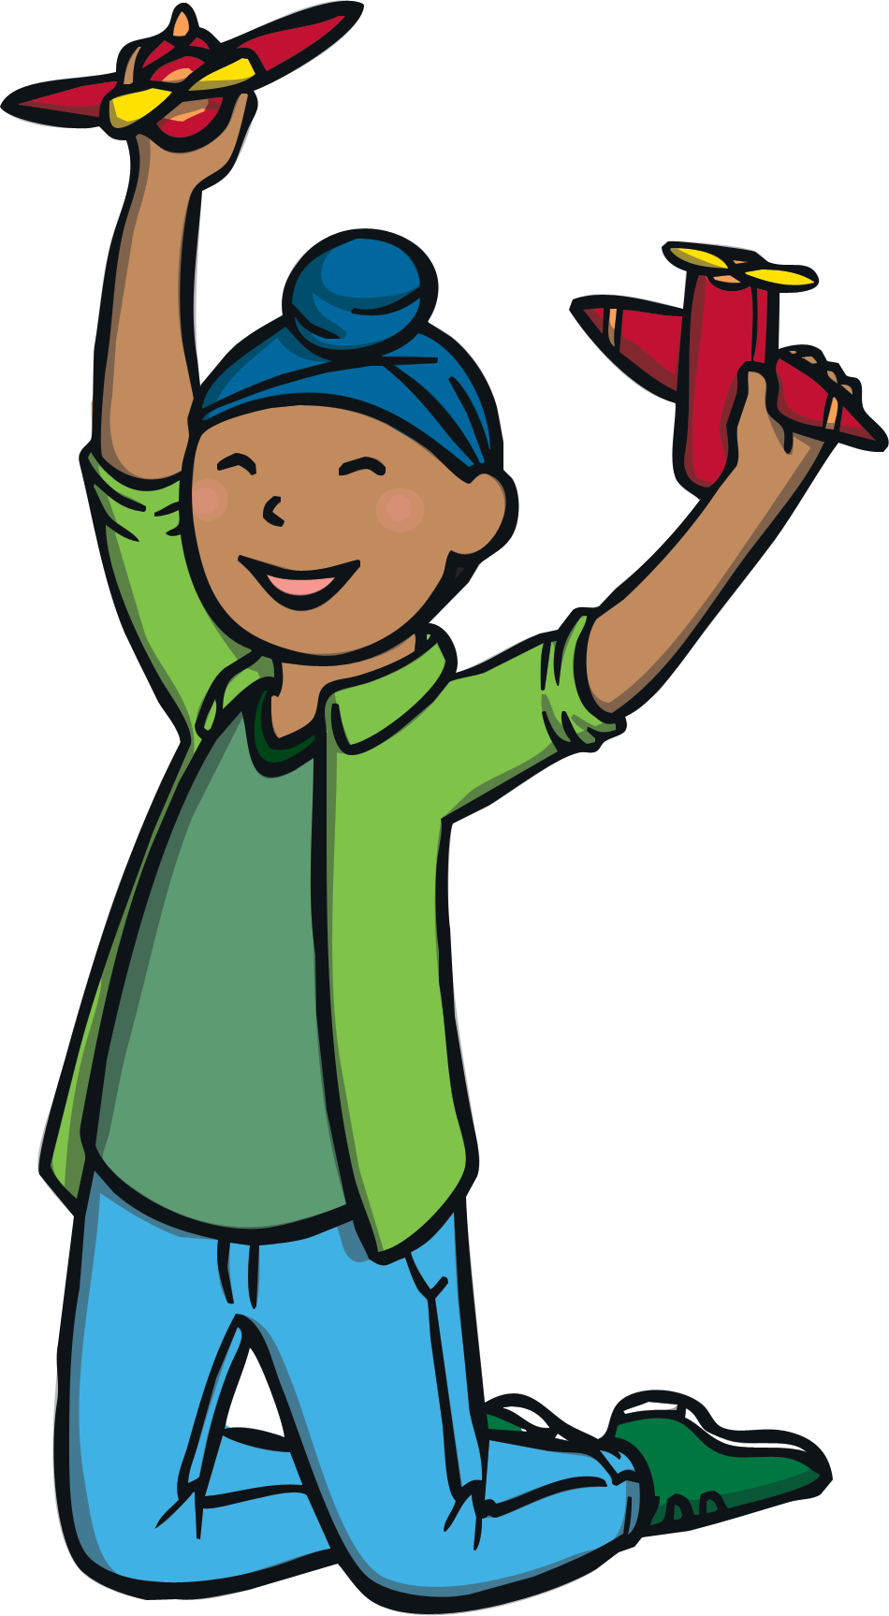
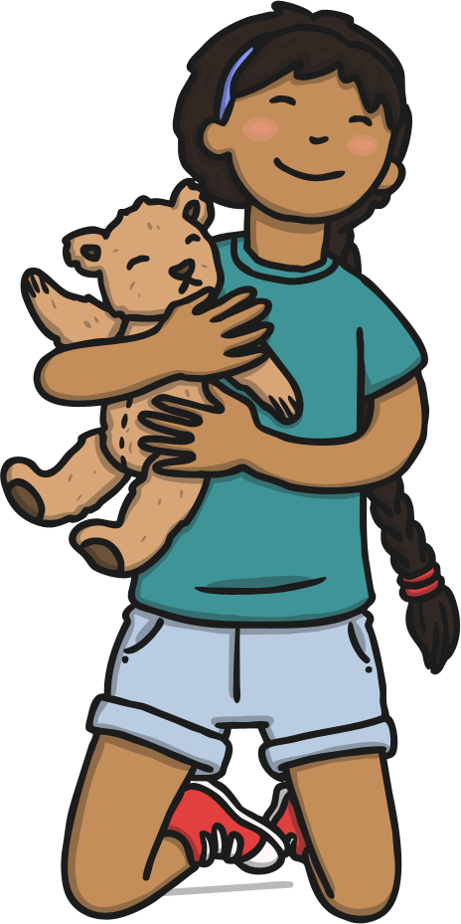
The Big Questions
What things make us feel unhappy or cross?
What can we do when we have uncomfortable feelings?

Slide 6
Reconnecting

Slide 7
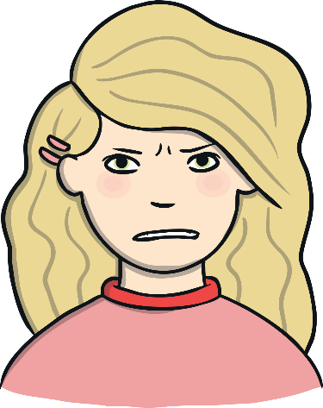
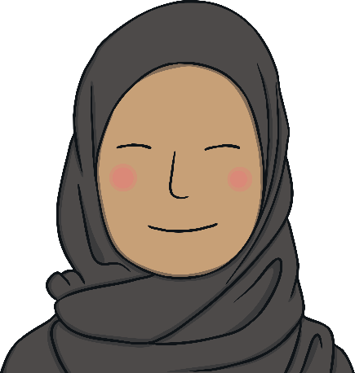
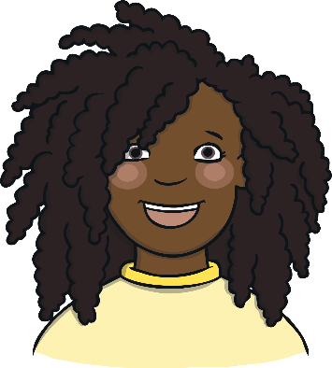
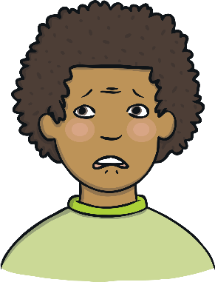
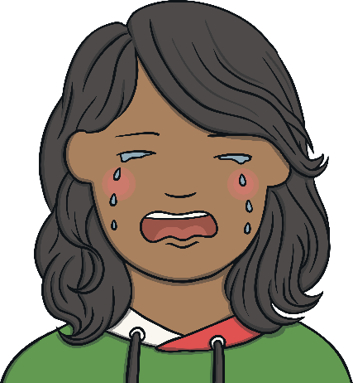
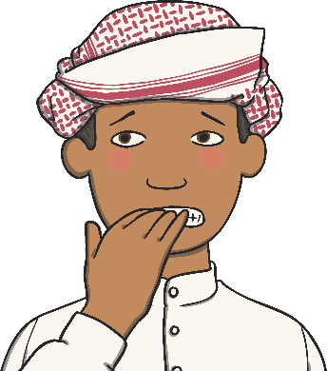
Feelings
We can feel lots of different ways – we can feel happy, we can feel sad, we can feel angry, we can feel excited and lots more besides!
Some feelings feel good inside but others can be uncomfortable – this means that they don’t feel very nice inside.
Learning about uncomfortable feelings helps us to know what to do when we are feeling them.
Which of the feelings do you think would be uncomfortable? Share your thoughts with a partner and then with the class.
Which feelings are being shown? Share your thoughts with a partner and then with the class.

Slide 8
Exploring

Slide 9
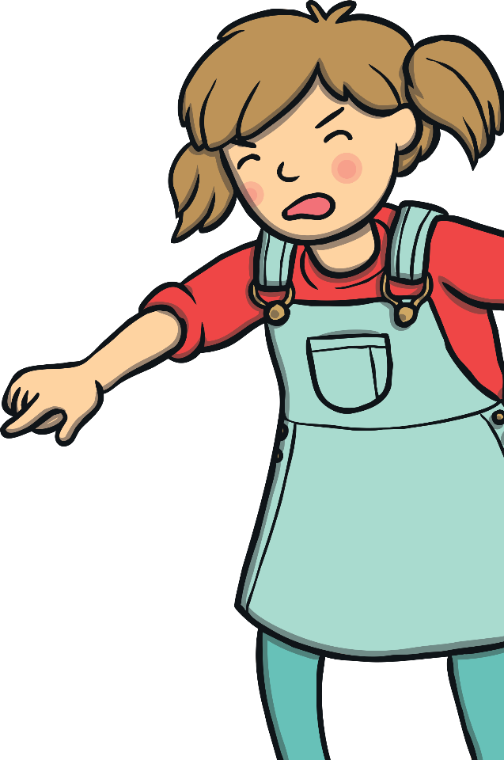
Feeling Unhappy and Cross
You can think about things that have already happened or you can imagine something that you know would make you feel unhappy or cross.
Sometimes we feel unhappy or cross. This is OK but it is important we know what to do when we are feeling this way.
Share your ideas with a partner and then, if you feel happy to do so, share them with the class.
What things make you feel unhappy or cross?

Slide 10
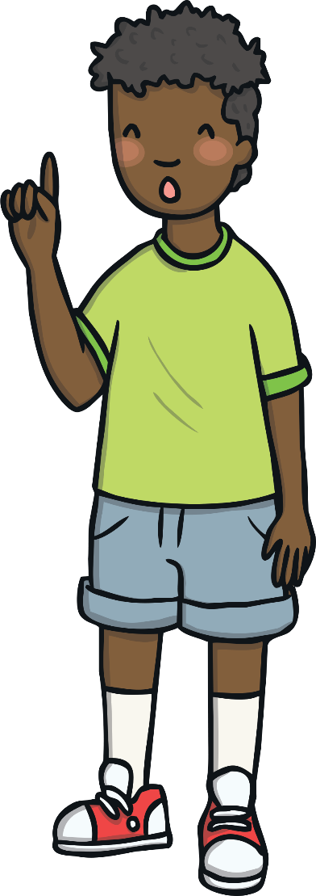
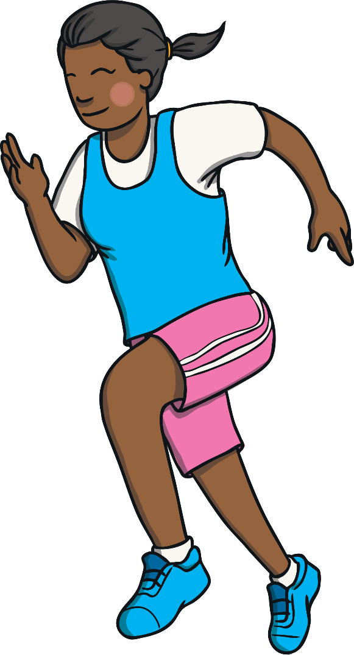
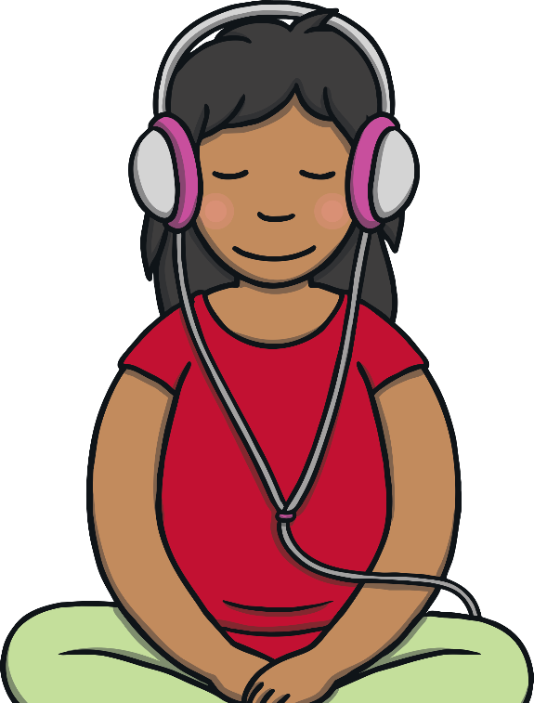
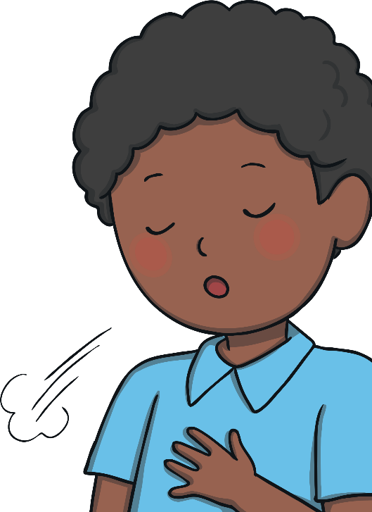
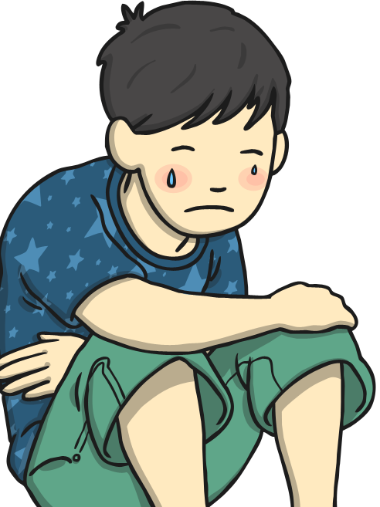
What We Can Do
It is OK at times to feel unhappy and cross but it is important we learn to cope with these feelings in the right way. This is so we don’t hurt others or ourselves.
Cry
Music
Which of these strategies do you think would work best for you? Share your thoughts with the class if you feel happy to.
If you are feeling unhappy or cross and feel like crying, then letting yourself do this can help your body relax. It is also a good way of showing others how you feel.
Listening to music can help you feel happier and relaxed. It gives you space to work through your feelings of sadness or being cross.
Breathe
What could we do when we have any uncomfortable feelings?
Take some time to calm down. Go to a quiet space and take some deep breaths.
Talk
Consolidating
Exercise
Share with someone you trust how you are feeling and why you are feeling like that. They could help you make it better.
Exercise makes people feel good and feel positive. It also gives you space to work through your sad or cross thoughts or feelings.
Reflecting

Slide 11
Consolidating

Slide 12
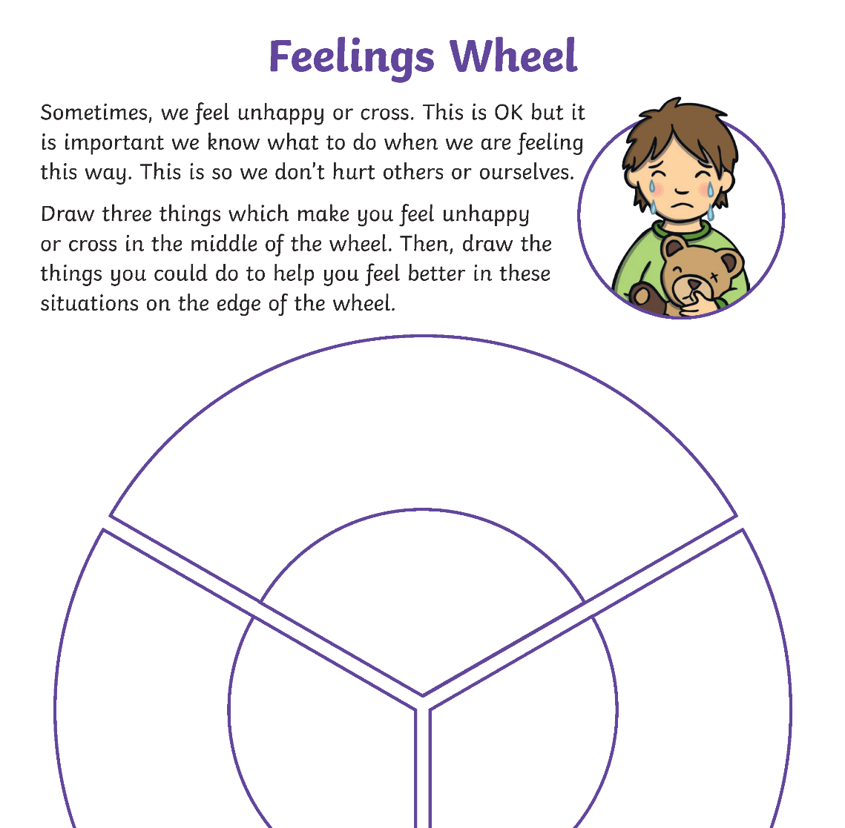
My Feelings Wheel
On your Feelings Wheel Activity Sheet, draw three things which make you feel unhappy or cross in the middle of the wheel. Then, draw the things you could do to help you manage your feelings and feel better in these situations on the edge of the wheel.

Slide 13
Reflecting

Slide 14
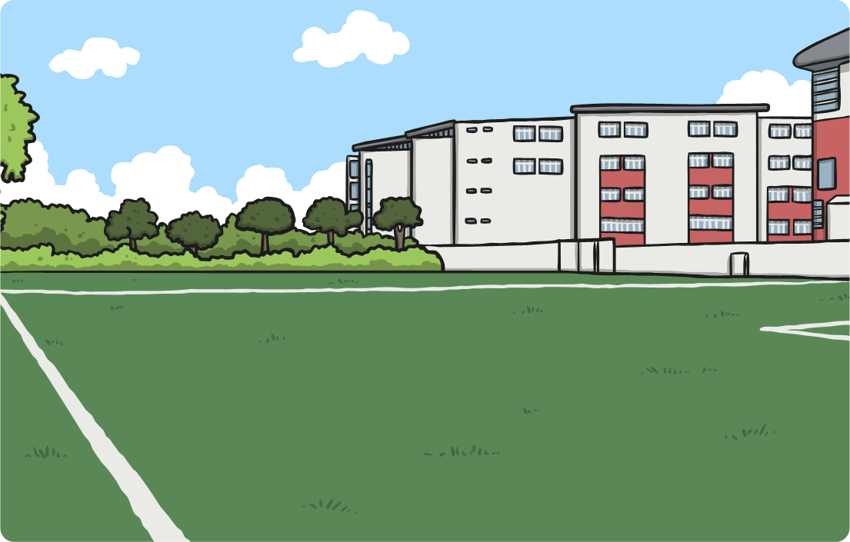
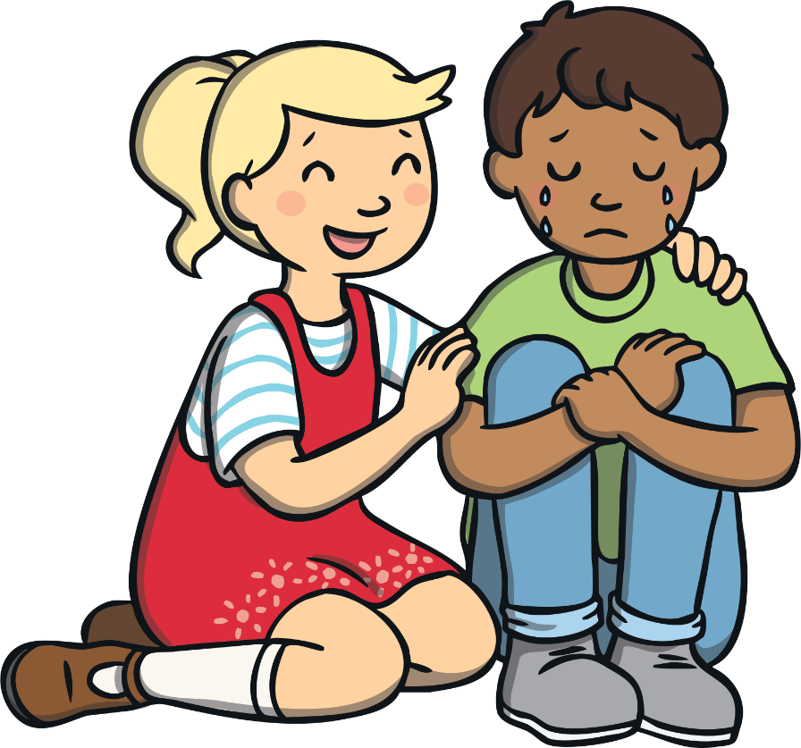
Helping Others
There are lots of ways we can help ourselves cope with uncomfortable feelings.
It is also important to help our friends if they are feeling unhappy or cross.
When you have finished, stick it on the large piece of paper at the front of the class.
What a lot of lovely, caring children we have in our class! Thank you!
On your sticky note, draw or write how you are going to try and help your friends if they are feeling unhappy or cross.

Slide 15
The Big Questions

Slide 16
The Big Questions
What things make us feel unhappy or cross?
What can we do when we have uncomfortable feelings?
Have you learnt anything new?

Slide 17
Aim
I can talk about the things that make me feel unhappy or cross and have ideas about what to do when I have these feelings.
Success Criteria
I can identify if a feeling is comfortable or uncomfortable.
I can describe what makes me feel unhappy or cross.
I can think about what I could do to help others if they were feeling unhappy or cross.

