Slide 1
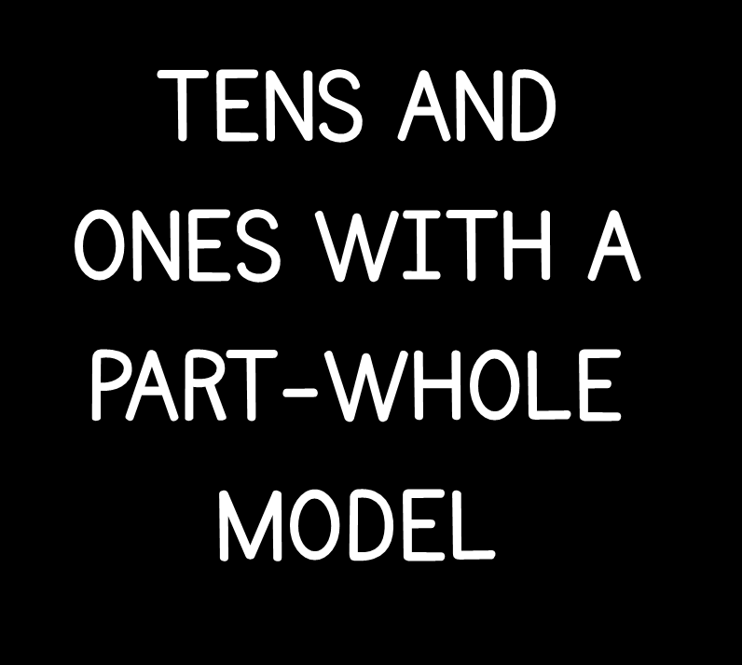

Slide 3


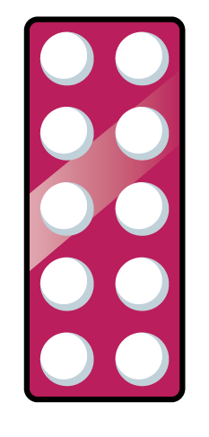



Which represents the number?
25
56
13

Slide 4
Which represents the number?
25
56
13

Slide 6
13

Slide 7

Have a think
15

Slide 8
Have a think
19

Slide 9
Have a think
29 is made up of 2 tens and 9 ones.
29

Slide 10
Have a think
0
29
29 is made up of __ tens and __ ones
29
29

Slide 11
Have a think
1
19
29 is made up of __ ten and __ ones
29
29

Slide 12
Have a think
25
2
5
__ is made up of __ tens and __ ones
20
29
?

Slide 13


Have a look
36
10
20
16
10
10
8
6
8
3
6
36
__ tens and __ ones = __
2
16
36
__ tens and __ ones = __

Slide 14
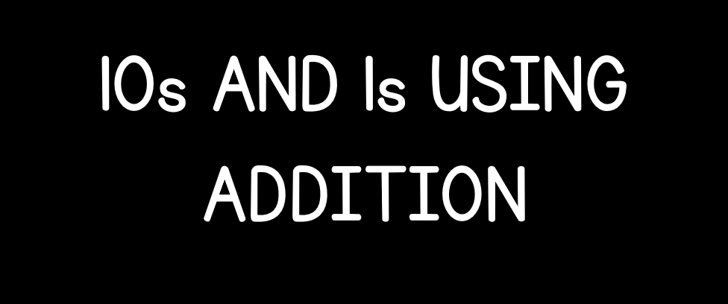

Slide 16
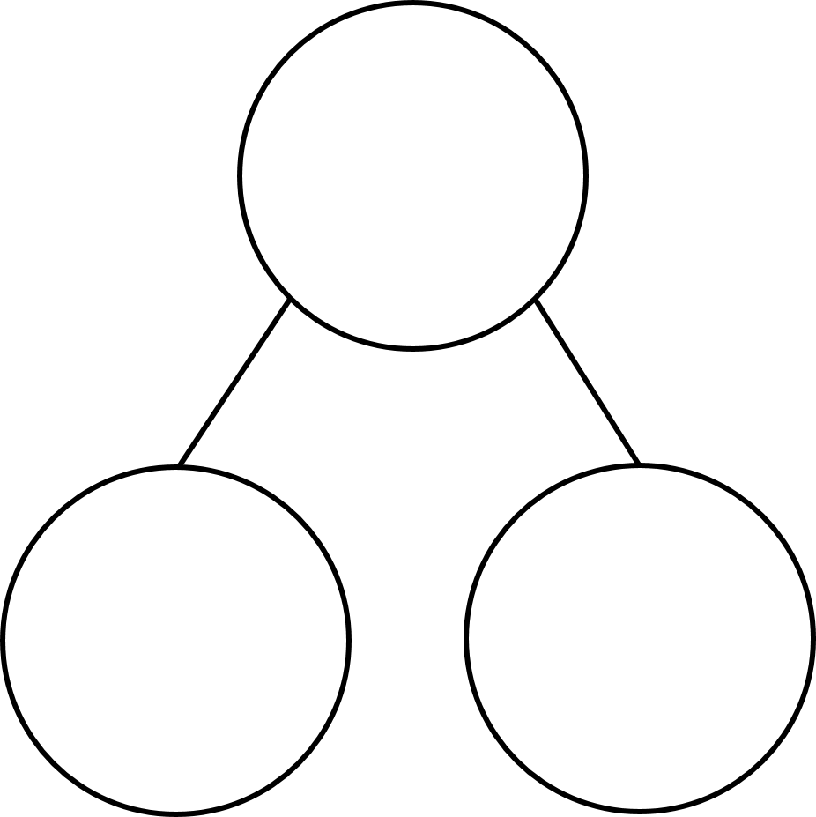
Complete the part-whole models
1)
2)
3)

Slide 17
Complete the part-whole models
1)
2)
3)
7
5
0

Slide 19
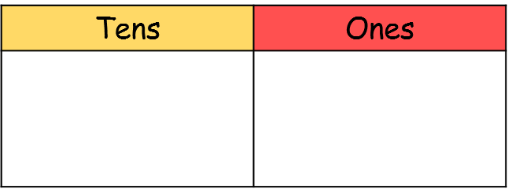
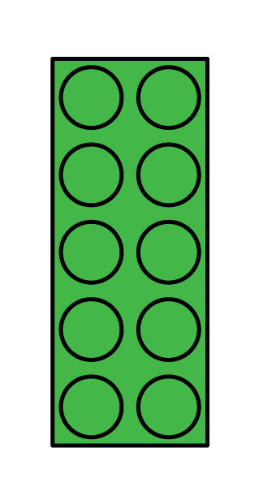

Have a think
24
15
41

Slide 20
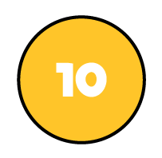

Have a think
24
56
24

Slide 21



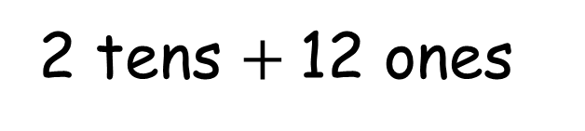
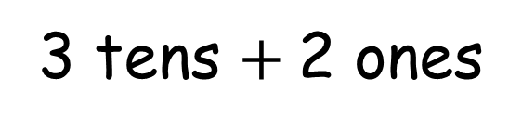
32
3 tens $+$2 ones
2 tens $+$12 ones

Slide 22
Have a think
16

Slide 23
Have a think
16
24

