Slide 1
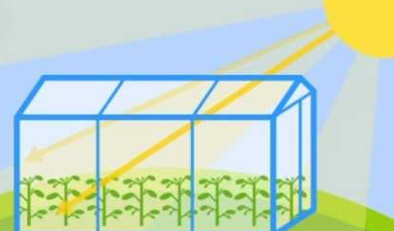
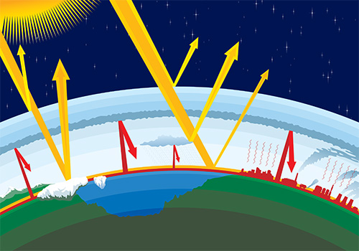
Your task
Research the green house gases and create a poster to show the greenhouse effect.

