Slide 1
PSHE and Citizenship
Relationships | VIPs
PSHE and Citizenship | Year 4 | Relationships | VIPs | Staying Friends | Lesson 2

Slide 3
Aim
I can create a list of positive actions needed to stay friends with my friends.
Success Criteria
I can be an anonymous friend to another child in my class.
I can explain ways to treat my friends to ensure we stay friends.
This resource is fully in line with the Learning Outcomes and Core Themes outlined in the PSHE Association’s Programme of Study.

Slide 4
The Big Questions

Slide 5
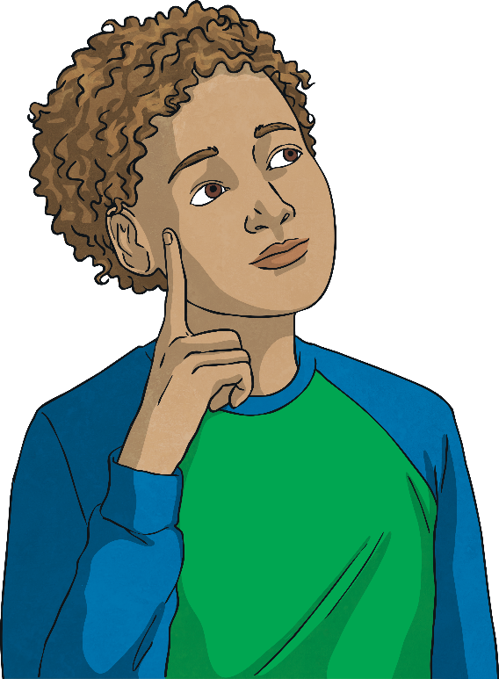
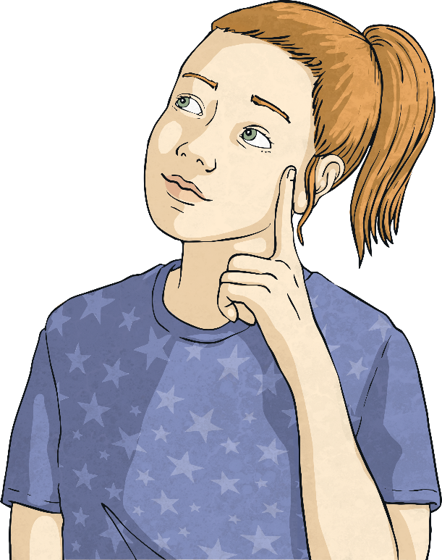
How should we treat our friends?
Why is it important to be kind to our friends?

Slide 6
Reconnecting

Slide 7
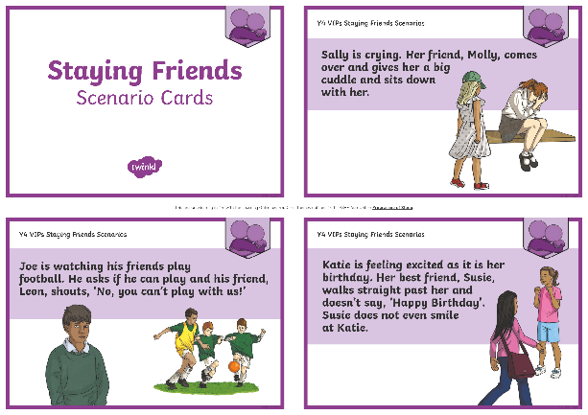
Staying Friends
In groups, look at your Staying Friends Scenario Cards and discuss together which show friends working at maintaining their friendships and which show behaviour that could end a friendship?
How would the children feel in each of the scenarios?
Focus on one child at a time and discuss how each child is feeling.

Slide 8
Exploring

Slide 9
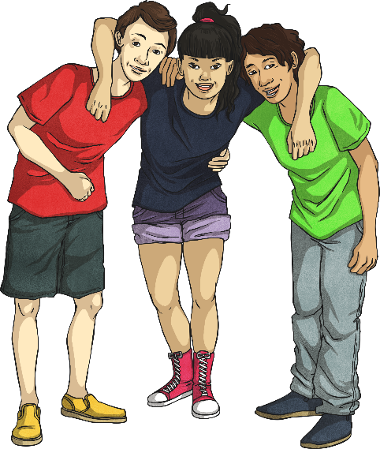
Being Good Friends
How should we treat our friends?
Let’s create a list of ways we should treat our friends.
Why is it important to treat our friends like this?
What could happen if we didn’t treat our friends like this?
If someone was not treating you well as a friend, what could you do?

Slide 10
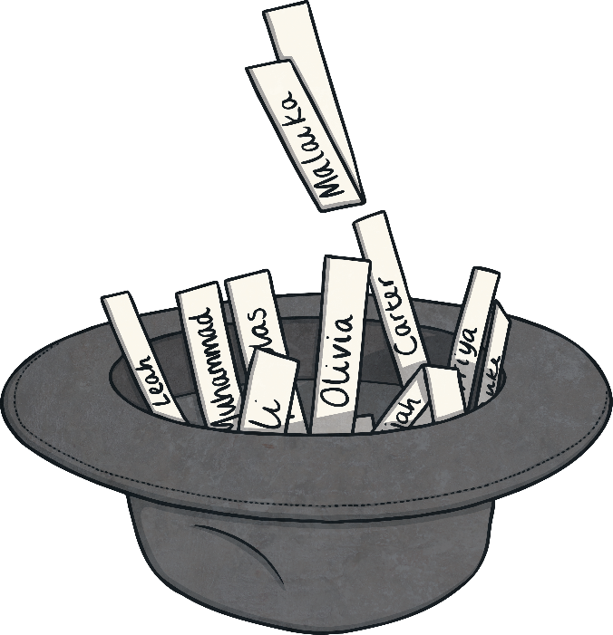
Anonymous Friends
Write your name on a piece of paper, fold the paper up and place it in the class hat.
Everyone will then pick a name out of the hat, one at a time.
The name written on the piece of paper is the person you have to be an anonymous friend to.
Do not tell anyone who you are being an anonymous friend to!

Slide 11
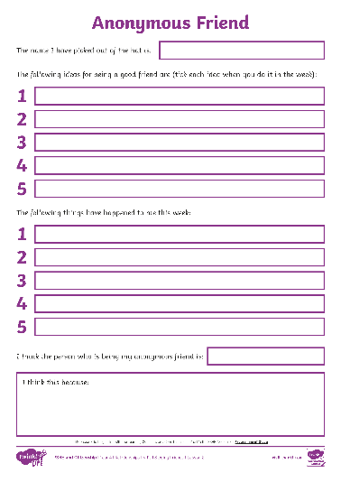
Anonymous Friends
This week you have to be a good friend as an anonymous friend. Doing something anonymously means not telling anyone it is you.
This could include being extra kind to them, looking out for them, complimenting them, playing games with them, etc.
At the end of the week, you will all have to guess the person who has been your anonymous friend. You will complete the Anonymous Friend Activity Sheet to focus on the ways to maintain friendships.
Consolidating
Reflecting

Slide 12
Consolidating

Slide 13
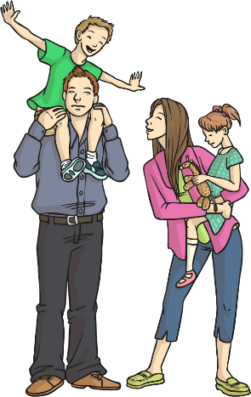
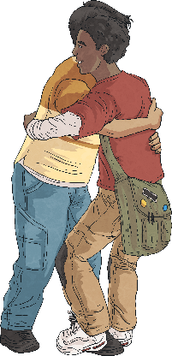
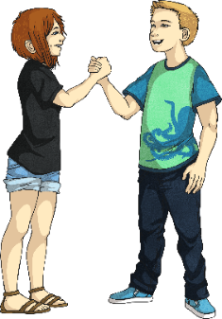
Old Friends
Why is it good to have old friends as well as new friends?
They will have known you through good times and bad times.
They are likely to know your other friends and family.
You know how loyal they are if you've been friends for a long time.
You know what they are like in their good times and bad times.

Slide 14
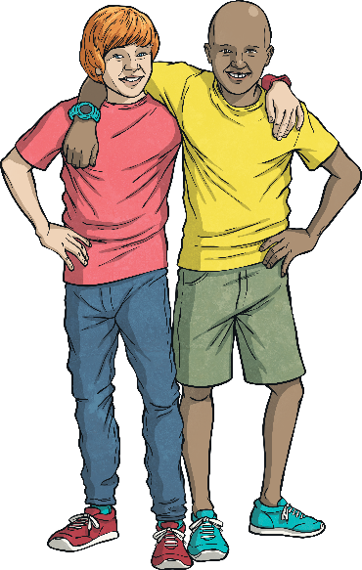
Old Friends
How can we maintain our friendships with our older friends?
regular contact
being caring towards them
showing an interest in them
remembering key times, for example, their birthday
making time for them
In pairs, discuss which of the ideas above are the most important to maintaining friends.
Friendship is hard work at times and we need to make a conscious effort sometimes to keep the friendship going.

Slide 15
Reflecting

Slide 16
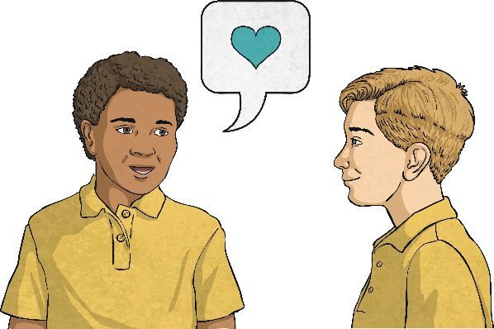
Kindness
Discuss with your partner why we need to be kind to our friends.
Why do we have friends?
Sometimes our friends go through difficult times. At these times our friends really need us to stick by them and help them through. This can include asking an adult for help if your friend is behaving differently from how they usually behave.
Why should we continue to be a friend when our friend is going through a difficult time?

Slide 17
The Big Questions

Slide 18
Why is it important to be kind to our friends?
How should we treat our friends?
Do you think your answers have changed at all from the beginning of the lesson? What have you learnt in today’s lesson about friendship?

Slide 19
Aim
I can create a list of positive actions needed to stay friends with my friends.
Success Criteria
I can be an anonymous friend to another child in my class.
I can explain ways to treat my friends to ensure we stay friends.

