Slide 1
LO: To use <, > and =

Slide 2
What do each of the signs mean?

Slide 3
Match the sign to the correct description.
<
equal to
>
less than
=
greater than

Slide 4
Use < , > or = to complete the comparisons.
>
=

Slide 5
Use < , > or = to complete the comparisons.
<
>

Slide 6
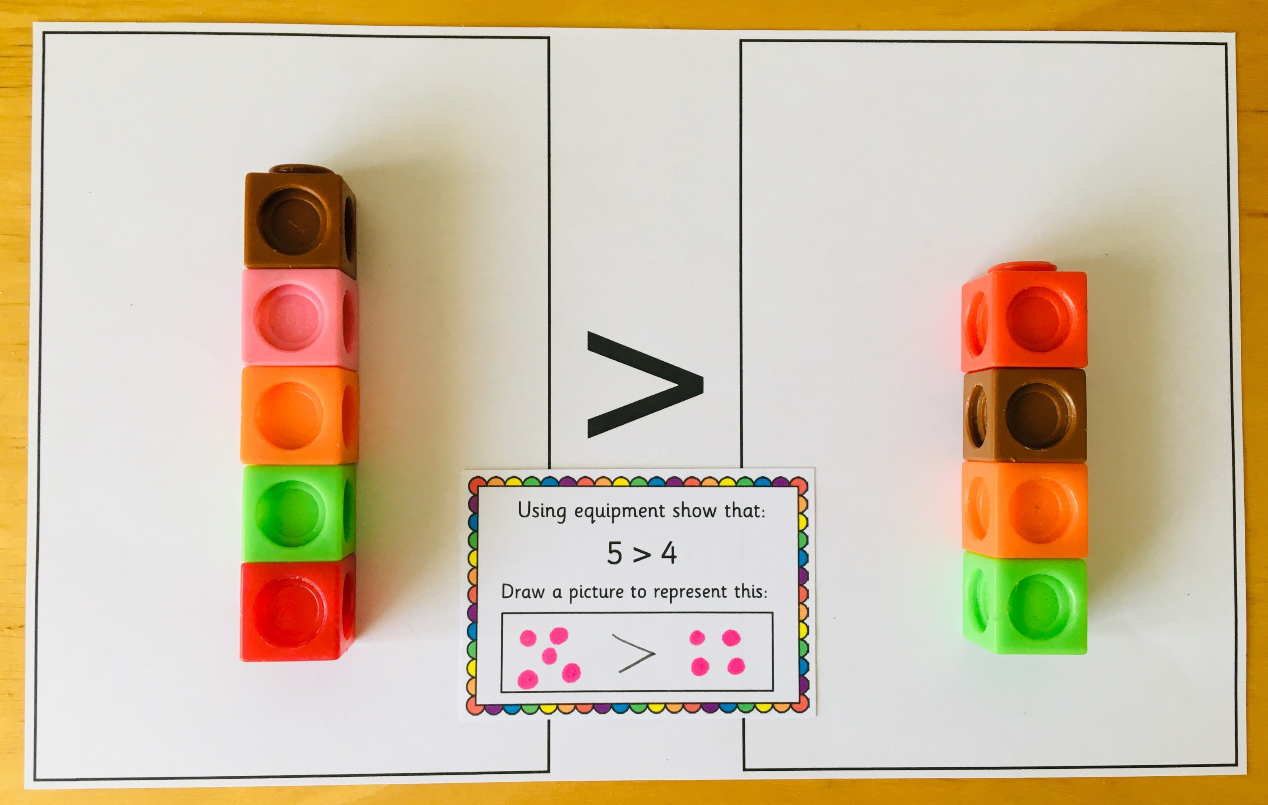
Practical:
Use equipment to show the comparison statements. Draw a picture to represent the comparison.

Slide 7
Plenary
Which numbers cannot go in the box? How do you know?
7 <
1 | 2 | 3 | 4 | 5 | 6 | 7 | 8 | 9 | 10

Slide 8
Lesson 4
Step: Compare numbers
(Practical)

Slide 9
Fluency
Use the number track to help you complete the sentences.
1 | 2 | 3 | 4 | 5 | 6 | 7 | 8 | 9 | 10
6
4
6
4
______ is the biggest number. ______ is the smallest number.
1
3
3
1
______ is the biggest number. ______ is the smallest number.

Slide 10
Fluency
Use the number track to help you complete the sentences.
1 | 2 | 3 | 4 | 5 | 6 | 7 | 8 | 9 | 10
7
5
7
5
5
7
______ is greater than ______. ______ is less than ______.
3
9
9
3
3
9
______ is greater than ______. ______ is less than ______.

Slide 11
Fluency
Use the number track to help you complete the statements.
1 | 2 | 3 | 4 | 5 | 6 | 7 | 8 | 9 | 10
5
10
10
5
5
10
______ >______ ______ < ______
9
7
9
7
7
9
______ >______ ______ < ______

Slide 12
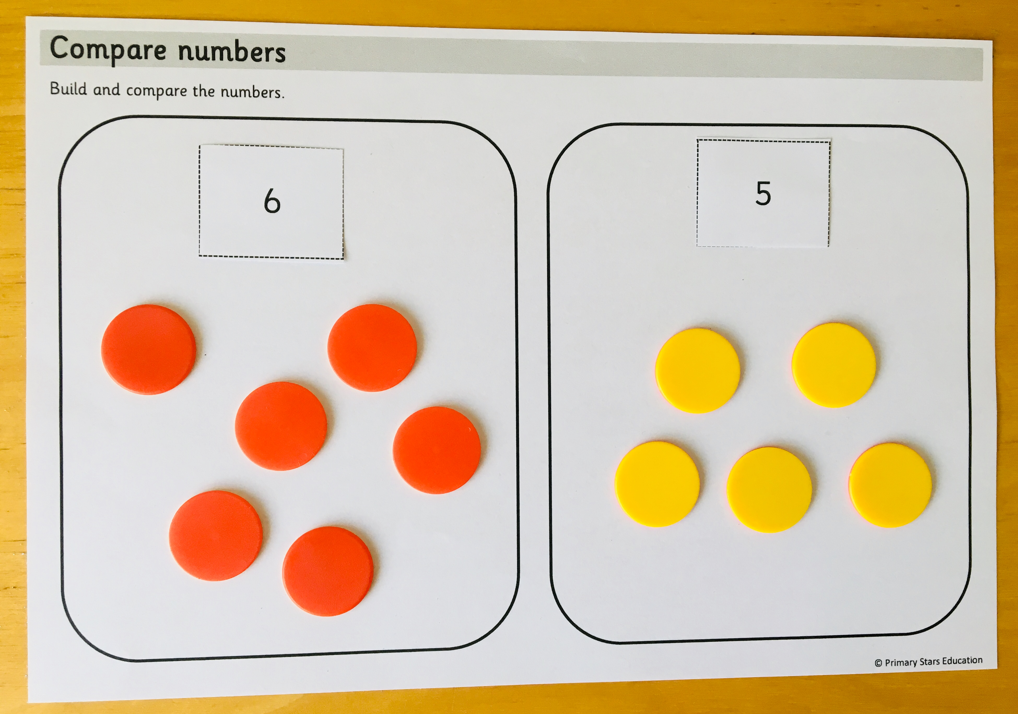
Fluency
Practical:
Select two number cards. Build the numbers and compare using < , > and =.

Slide 13
Reasoning
The statement shows 4 is greater than 5.
4 < 5
Is Sue correct? Explain how you know.
No. The statement shows 4 is less than 5.

Slide 14
Problem solving
Using the numbers 0 to 10, complete the statement so it is correct.
is less than
How many different ways can you find?

Slide 15
Lesson 5
Step: Compare numbers

Slide 16
Fluency
Use the number track to help you complete the sentences.
1 | 2 | 3 | 4 | 5 | 6 | 7 | 8 | 9 | 10
7
3
7
3
______ is the biggest number. ______ is the smallest number.
4
9
9
4
______ is the biggest number. ______ is the smallest number.

Slide 17
Fluency
Use the number track to help you complete the sentences.
1 | 2 | 3 | 4 | 5 | 6 | 7 | 8 | 9 | 10
2
5
5
2
2
5
______ is greater than ______. ______ is less than ______.
8
6
8
6
6
8
______ is greater than ______. ______ is less than ______.

Slide 18
Fluency
Complete the statements.
10
6
10
6
6
10
______ > ______ ______ < ______
7
4
7
4
4
7
______ > ______ ______ < ______
3
8
8
3
3
8
______ > ______ ______ < ______
2
6
6
2
2
6
______ > ______ ______ < ______

Slide 19
Reasoning
Tick (✓) true or false for each statement.
 | True | False
four > 3
9 = nine
8 < seven
six > five
✓
✓
✓
✓

Slide 20
Problem solving
Complete the statement to make it true.
6 >
How many different ways can you complete this?
5, 4, 3, 2, 1 or 0.

