Slide 1
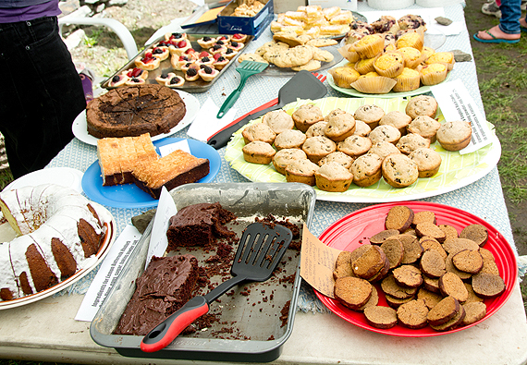
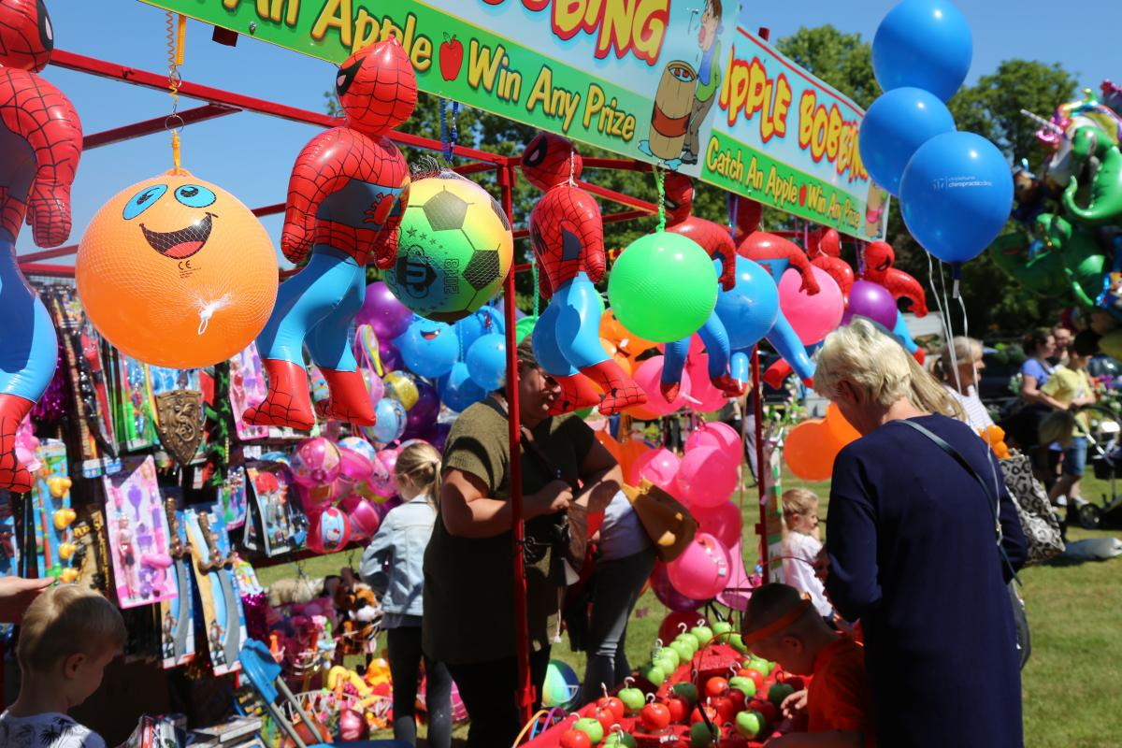
Iqra Inquirer
COMMUNITY SPIRIT SOARS AT IQRA
__________________________________________________________________________________________________________________________________________________________________________________________________________________________________________________________________________________________________________________________________________________________________________________________________________________________________________________________________
__________________________________________________________________________________________
____________________________________________________________________________________________________________________________________________________________________________________________________________________________________________________________________________________________________________________________________________________________________________________________________________________________________________________________________________________________________

