Slide 1
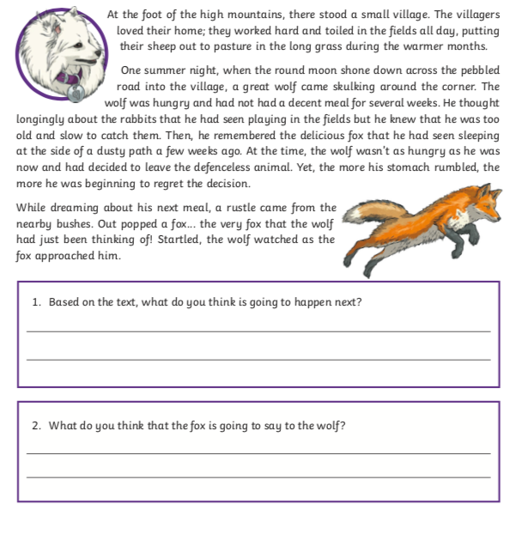
Starter
Have a go at answering the questions on your sheet.
Talk Partners

Slide 2
LO: To make comparisons between Victorian school life and modern school life Must: Must analyse a text looking at structure, genre and language Should: Retrieve simple facts and use this to infer meaning Could: Use justification to support accurate inference

Slide 3
LO: To make comparisons between Victorian school life and modern school life Must: Must analyse a text looking at structure, genre and language Should: Retrieve simple facts and use this to infer meaning Could: Use justification to support accurate inference
Talk Partners
Have a look at the text in front of you.
Think about:
What type of text is it?
How do you know?
Why has the author used subheadings?

Slide 4
LO: To make comparisons between Victorian school life and modern school life Must: Must analyse a text looking at structure, genre and language Should: Retrieve simple facts and use this to infer meaning Could: Use justification to support accurate inference
Shared Read
P5 only
Expectations
Fingers following
Highlight unfamiliar words and phrases
Annotate with notes

Slide 5
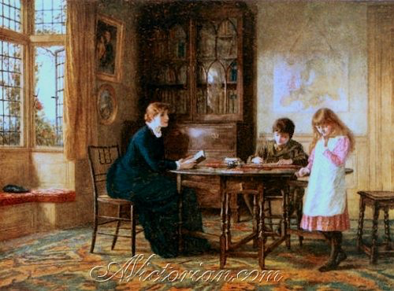
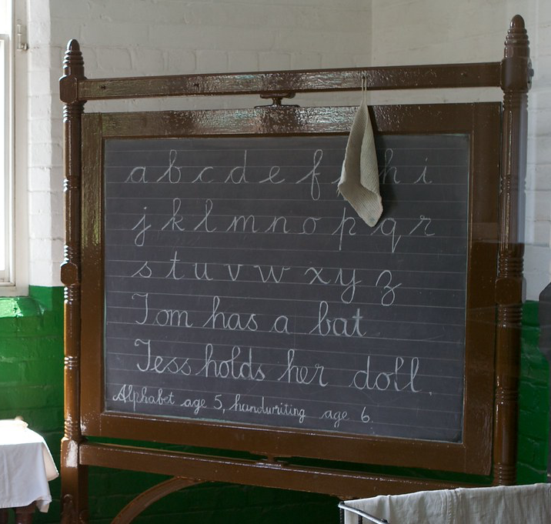
Governess
Blackboard

Slide 6
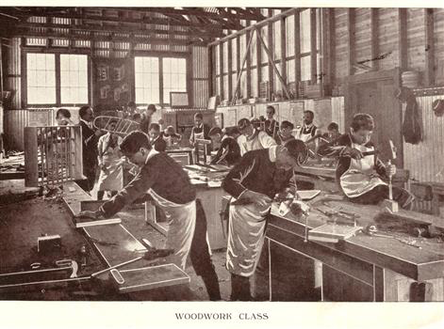
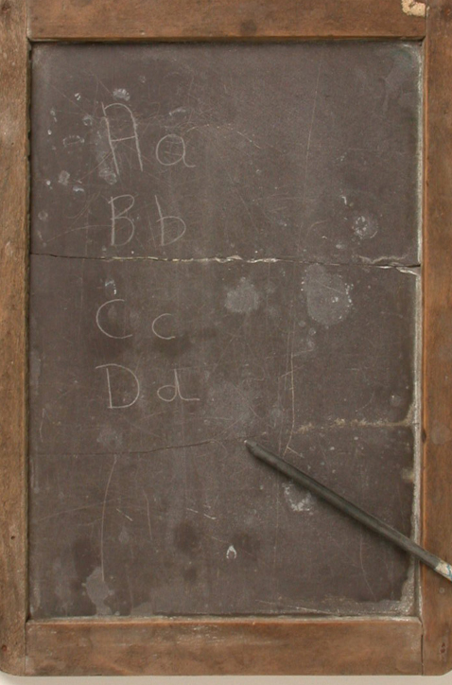
Woodwork
Slate

Slide 7
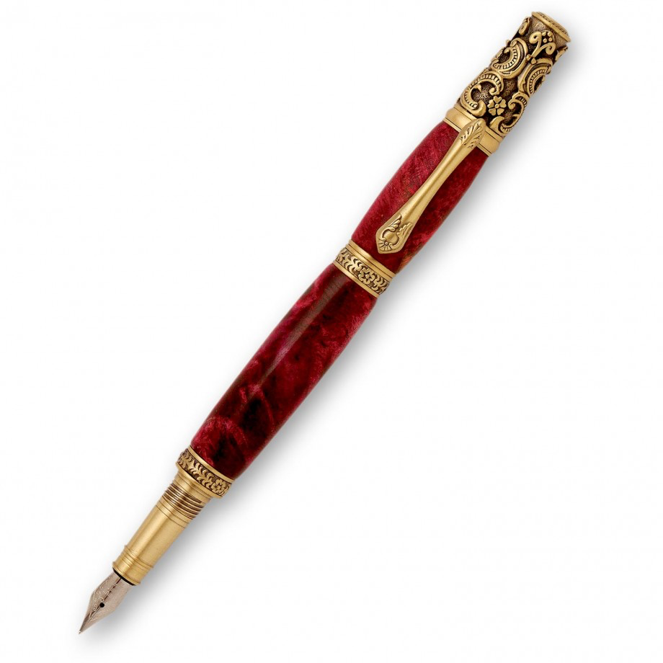
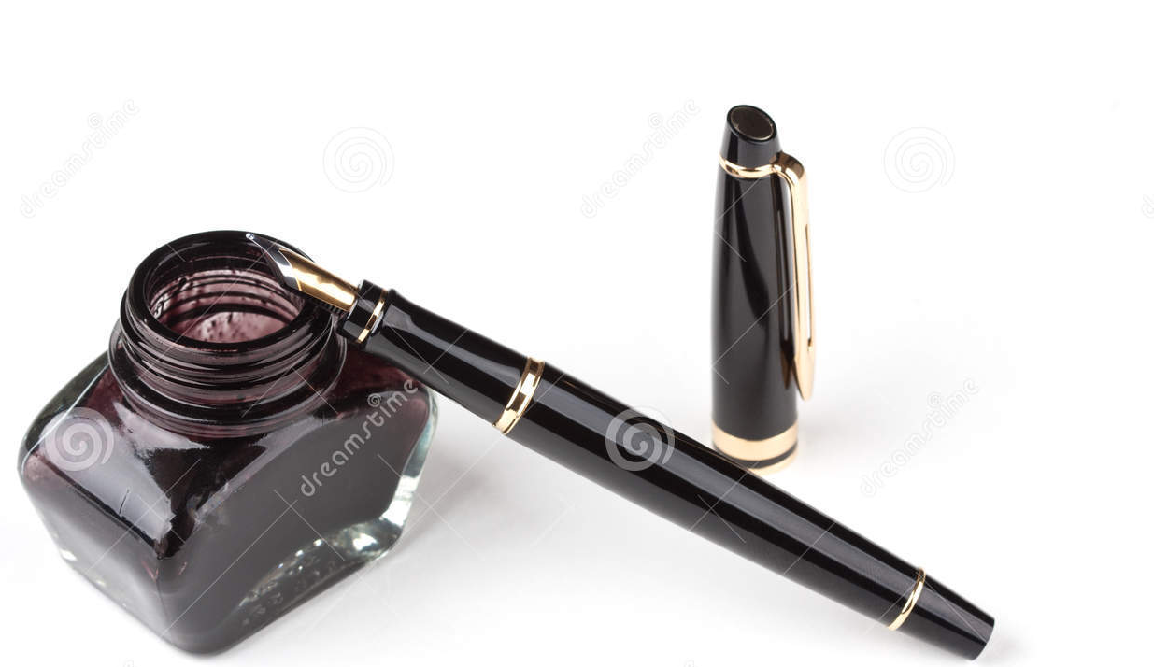
Fountain Pen
Inkwell

Slide 8
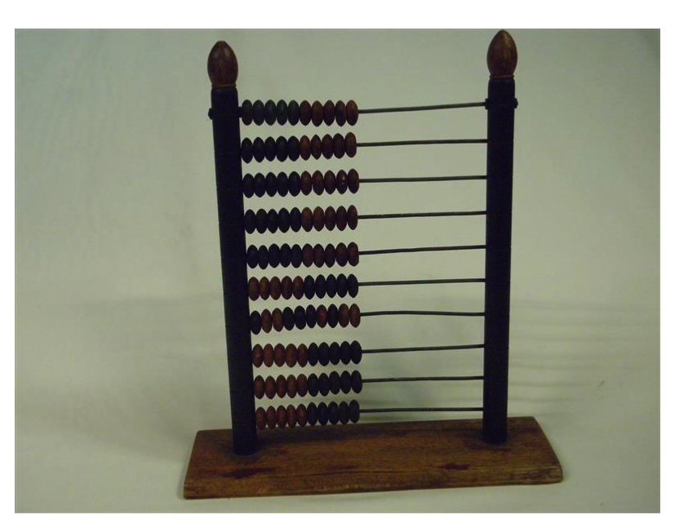
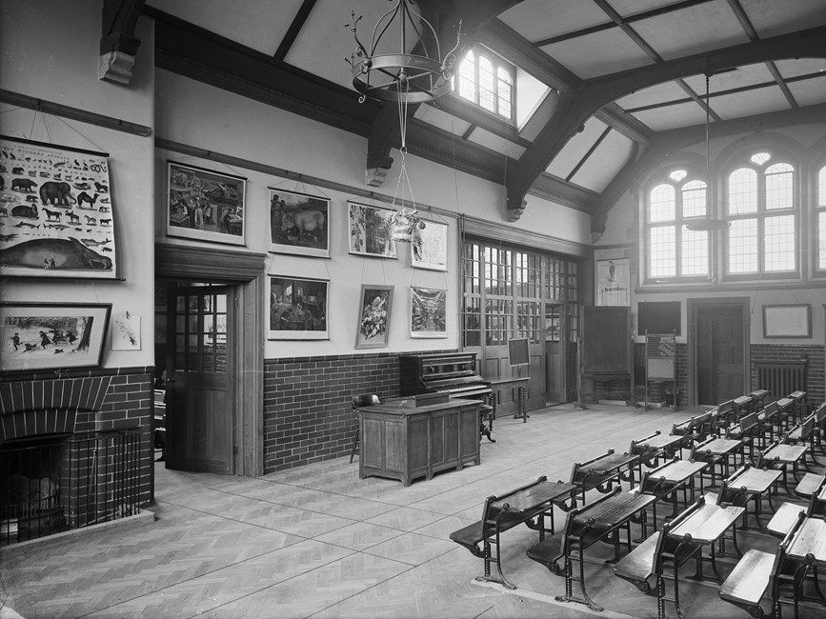
Abacus

Slide 9
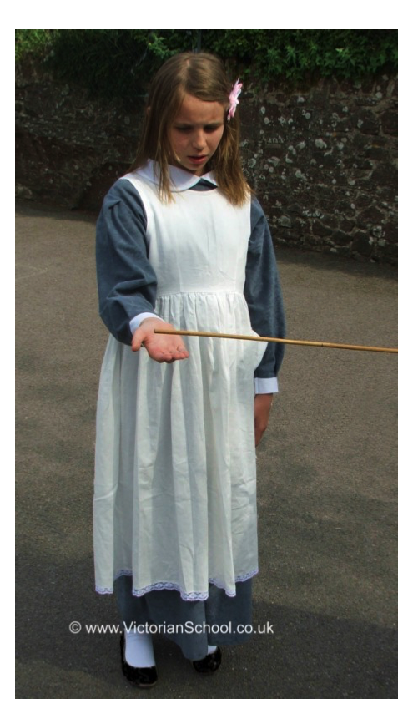
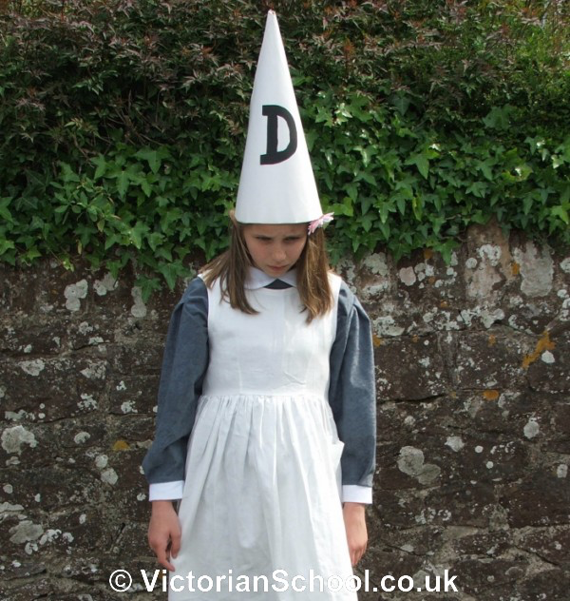
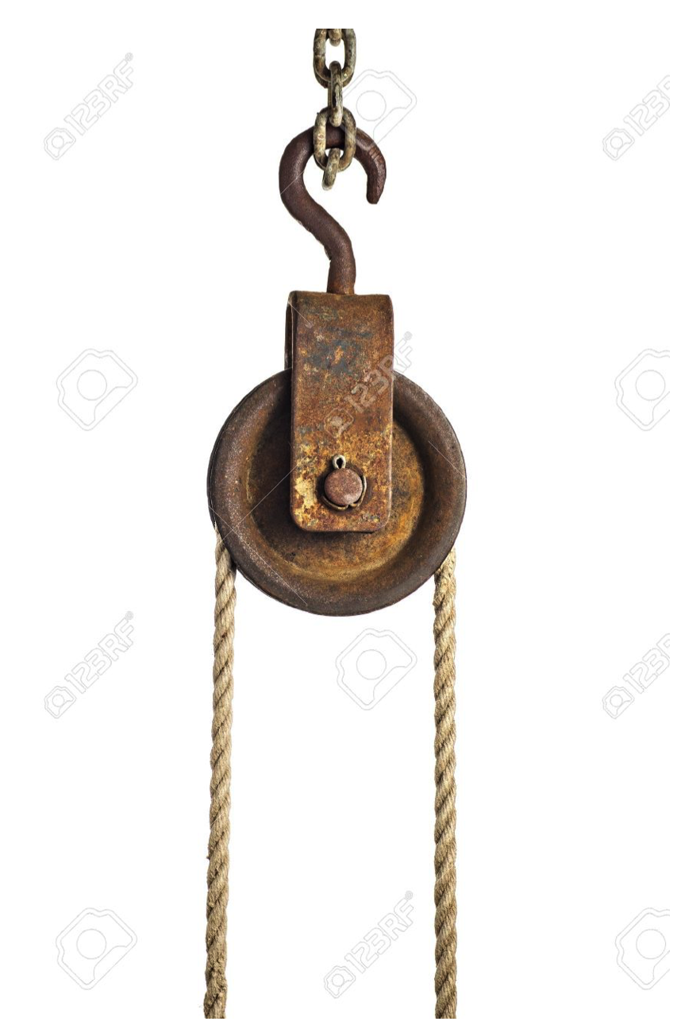
Pulley
Cane
Dunce’s hat

Slide 10
LO: To make comparisons between Victorian school life and modern school life Must: Must analyse a text looking at structure, genre and language Should: Retrieve simple facts and use this to infer meaning Could: Use justification to support accurate inference
Teacher Model
Who provided free schooling for the poor children?
Identify one way how the teachers were different in Victorian times.
Look at the section ‘Lessons’. Give one way Victorian schools are:
Similar to today’s schools
Different from today’s schools

Slide 11
LO: To make comparisons between Victorian school life and modern school life Must: Must analyse a text looking at structure, genre and language Should: Retrieve simple facts and use this to infer meaning Could: Use justification to support accurate inference
Talk Partners
Read p6 with your partner
Choose your question
Which two things inside the classroom helped pupils?
Look at the section ‘punishments’. Write down one way how the punishments were different in Victorian times
Look at the section ‘Lessons’. Identify one lesson where Victorian children were:
Taught together
Taught separately

Slide 12
LO: To make comparisons between Victorian school life and modern school life Must: Must analyse a text looking at structure, genre and language Should: Retrieve simple facts and use this to infer meaning Could: Use justification to support accurate inference
Your Task
Have a go at answering the questions and then move on to the challenges

Slide 13
LO: To make comparisons between Victorian school life and modern school life Must: Must analyse a text looking at structure, genre and language Should: Retrieve simple facts and use this to infer meaning Could: Use justification to support accurate inference
Plenary
Plenary
In 1880, the law changed. After that, every child had to go to school. Explain the positive impact this had on children and society.

Slide 14
Answers
1.
2. Girls were taught at home. Boys went to private school.
3. Woodwork
4. Then: Slate/something sharp to scratch letters, ink pen Ink well. Now: paper/exercise books, pens/pencils etc
5. Calling parents/detention etc
1.
2. Girls were taught at home. Boys went to private school.
3. No cane/hung from basket/ Dunce’s hat. Instead booster classes, detention, calling parents etc
4. Then: Slate/something sharp to scratch letters, ink pen Ink well. Now: paper/exercise books, pens/pencils etc
5.( Mark using CT discretion)
9:10 – 10:10 | Bible work
12:00 – 2:00 | Lunch
4:30 – 5:00 | Reading
11.30-12.00 | Writing
Skipping school | The cane
Being really naughty | Hung from the ceiling in a wicker basket
Not keeping up with the lessons | Dunce’s hat

Slide 15
Answers
1.
2. Girls were taught at home. Boys went to private school.
3. Then: Slate/something sharp to scratch letters, ink pen Ink well. Now: paper/exercise books, pens/pencils etc
4. Mark using CT discretion)
5.( Mark using CT discretion)
Skipping school | The cane
Being really naughty | Hung from the ceiling in a wicker basket
Not keeping up with the lessons | Dunce’s hat

