Slide 1
Starter
Talk Partners
Match the words to their definitions

Slide 2
LO:To understand how meaning is enhanced through choice of language Must: Skim and scan to retrieve relevant information Should: comment on the author’s choice of language Could: Use justification to support accurate inference

Slide 3
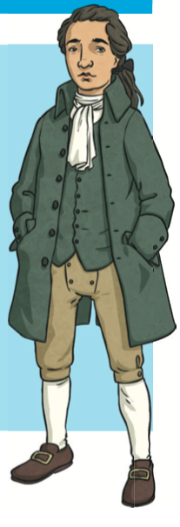
LO: To understand how meaning is enhanced through choice of language Must: Skim and scan to retrieve relevant information Should: comment on the author’s choice of language Could: Use justification to support accurate inference
What type of text is this?
What genre does it belong to?
Adventure?
Mystery?
Fantasy?

Slide 4
LO: To understand how meaning is enhanced through choice of language Must: Skim and scan to retrieve relevant information Should: comment on the author’s choice of language Could: Use justification to support accurate inference
Shared Read
Pg 2 only
Expectations
Fingers following
Highlight unfamiliar words and phrases
Annotate with notes
*…have a go at reading your text and answering the questions.

Slide 5
Salt Marshes
Sea-fowls
Herons
Lagoon
Oysters
Channel
Dike of pebbles
Inn
Mohune Family Shield
Backgammon
Trestle Table

Slide 6
LO: To understand how meaning is enhanced through choice of language Must: Skim and scan to retrieve relevant information Should: comment on the author’s choice of language Could: Use justification to support accurate inference
* …have a go at the practice questions on your tables
Teacher Model
In the first paragraph, the author uses the phrase ‘…it loses itself …’
Why has the author used this to describe the stream?
Look at the paragraph beginning’ The why not’ The author has used words like ‘ruins, ‘overgrown’, ‘deserted’’ and ‘grey’ What do these words suggest about the Mohunes?
‘Miss Arnold who was kind to me in her own fashion but too strict and precise ever to make me love her.’
Give two impressions this gives you of John’s Aunt

Slide 7
LO: To understand how meaning is enhanced through choice of language Must: Skim and scan to retrieve relevant information Should: comment on the author’s choice of language Could: Use justification to support accurate inference
Read pg3 with your partner
Choose 2 questions
Talk Partners
In the third paragraph, the author uses the phrase ‘My heart was in my mouth…’ Why has the author used this to describe how John was feeling?
Read the second paragraph. The author has used words like ‘’silent’ , ‘morose’ and ‘scowled’ . What do these words suggest about Elzevir Block?
‘…they would speak also of widows helped, and sick comforted with unknown gifts, and hint that some of them came from Elzevir Block for all he was so grim and silent’.
Give two impressions this gives you of Elzevir Block.

Slide 8
LO: To understand how meaning is enhanced through choice of language Must: Skim and scan to retrieve relevant information Should: comment on the author’s choice of language Could: Use justification to support accurate inference
Your Task
Complete the questions.
Glue into books
Choose your challenges and answer in full sentences.

Slide 9
LO: To understand how meaning is enhanced through choice of language Must: Skim and scan to retrieve relevant information Should: comment on the author’s choice of language Could: Use justification to support accurate inference
Plenary
Plenary
At the end of the extract, John Trenchard and Ratsey have just entered the ’Why Not? ‘ Do you think Elzevir Block would be pleased to see them?
Use evidence from the text to support your answer.

