Slide 1
LO: understand the function of teeth
Success criteria:
I can identify the different types of teeth
I can explain the function of each type of tooth
I know how to keep my teeth healthy
I can begin to use knowledge of an animal’s diet to identify which teeth belong to which animal

Slide 2
Key Vocabulary
teeth
evidence
molars
saliva
incisors
canines
chew
jaw
digestion

Slide 3
Watch the video and discuss as a class
https://www.youtube.com/watch?v=b5CPd1_r03s

Slide 4
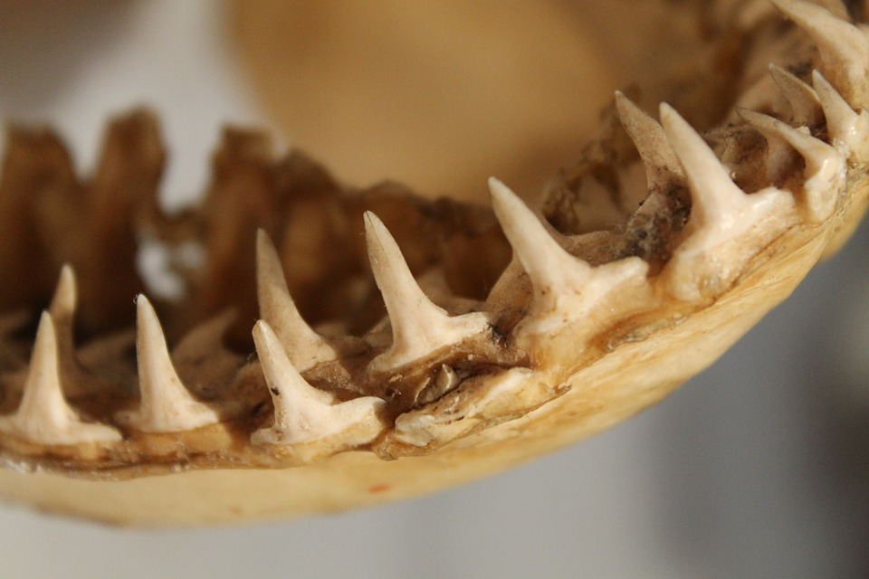
Excuse me are these your teeth?
No? Who do you think they belong to?

Slide 5
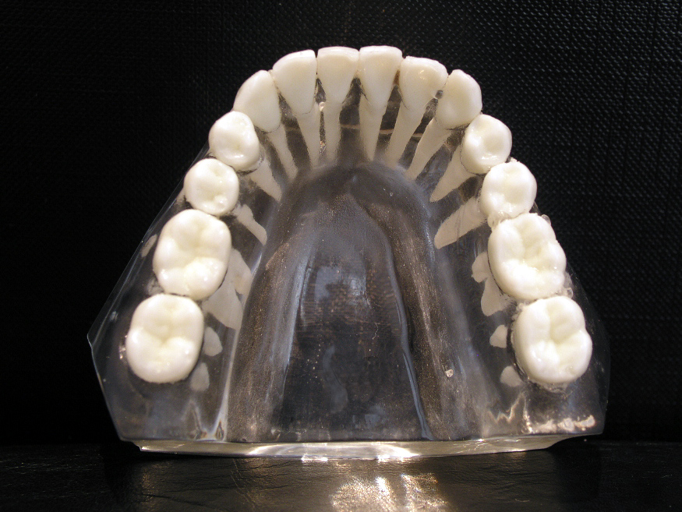
Feel your teeth with your tongue.
Do all your teeth feel the same?

Slide 6
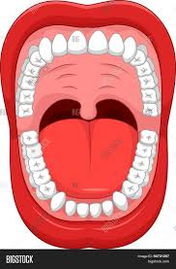
Partner talk
What do you know about teeth?
How can we keep them healthy?
Why do you think we have different types of teeth?
What is their purpose?
Have a look at the diagram on the science display. Which part of the digestive system is linked to the teeth?

Slide 7
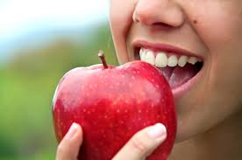
Think of when you bite an apple...
Which teeth do you use to bite, tear and chew.
Can you chew using your front teeth? Why not?

Slide 8
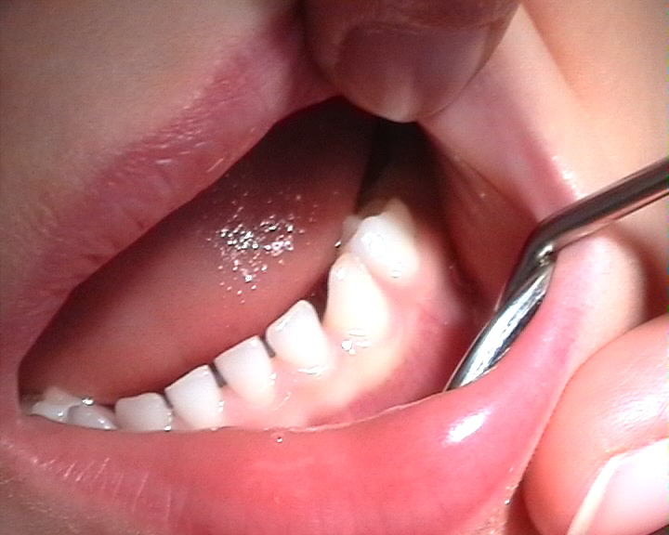
I don’t need to worry about taking care of my baby teeth as I get new ones anyway!
True or false?
False!
Poor dental care could cause other problems like gum disease and could also damage adult teeth (which are lying under the baby teeth waiting to emerge).

Slide 9
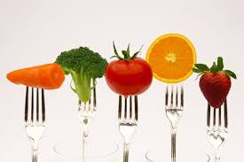
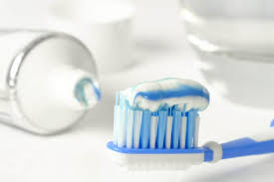
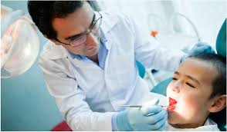
So how can we keep our teeth healthy?
Brush your teeth twice a day
Avoid lots of sugary drinks and sweets
Visit the dentist regularly
https://www.youtube.com/watch?v=aOebfGGcjVw

Slide 10
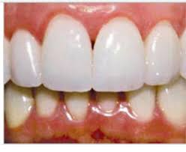
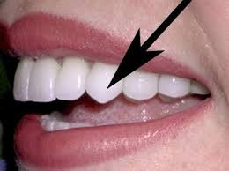
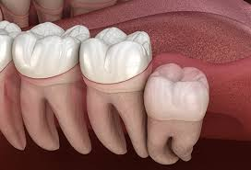
The different types of teeth
Incisors
Canines
Molars
Why are there different types?
Used for biting and cutting food
Used for tearing and ripping food
Used for crushing and grinding food

Slide 11
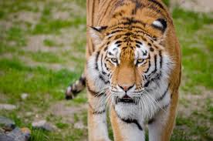
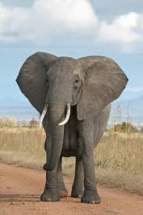
What about animal teeth…
Do other animals have the same type of teeth as humans?
Why? Why not?
​ ​
Why do different animals have different teeth?

Slide 12
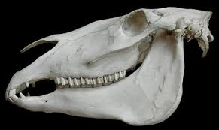
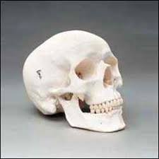
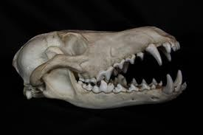
Carnivores are animals that eat meat. They have sharp canine teeth that they use to tear meat, but fewer molars for chewing. Canine teeth are long and pointed - such as the ones you see when a lion or tiger roars.
Herbivores are animals that only eat plants. They have strong, flat molars that, like the teeth towards the back of your mouth, are perfect for grinding up plant matter.
Herbivores may also have sharp incisors that help them tear plant matter so they can eat it.
Omnivores eat both plants and animals, so they need a variety of teeth types for eating different foods. Humans have canines and incisors to rip and molars in the backs of our mouths grind food. Chimpanzees, raccoons, and bears are all omnivores.
Can you think of examples for each of these?

Slide 13
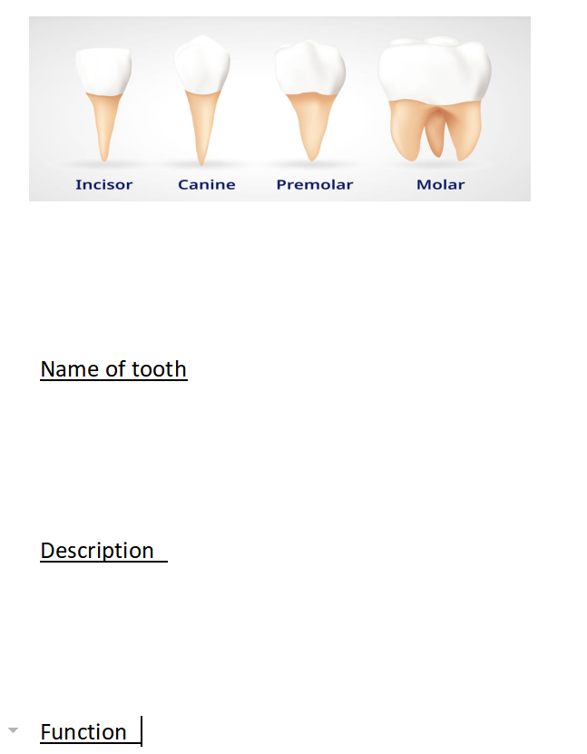
Task
E/T/C: Stick in the picture of teeth.
Write a description and the function of each type of tooth under the shown subheadings.
A/I: Stick in the sheet and write the name of each tooth and the function. Use the information pack to help you.

Slide 14
Plenary
Why do animals have different teeth?
Sheep have these teeth because ...
Lions have these teeth because....
Humans have these teeth because....

Slide 15
LO: To understand the function of teeth
Success criteria:
I can Identify the different types of teeth
I can explain the function of each type of teeth
I know how to keep my teeth healthy

