Slide 1
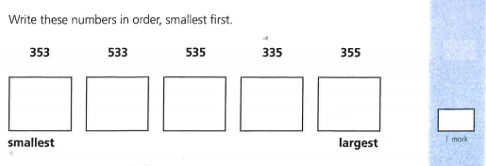
Emma wants to add 356. Which two numbers will it go before and after?
Emma wants to add 356. Which two numbers will it go before and after?

Slide 2
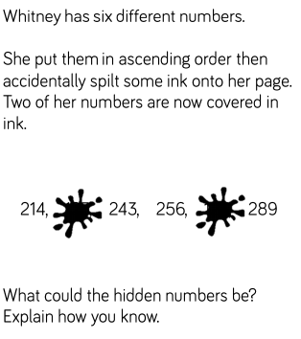

Slide 3
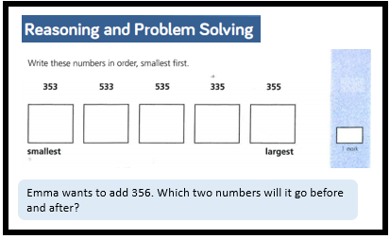
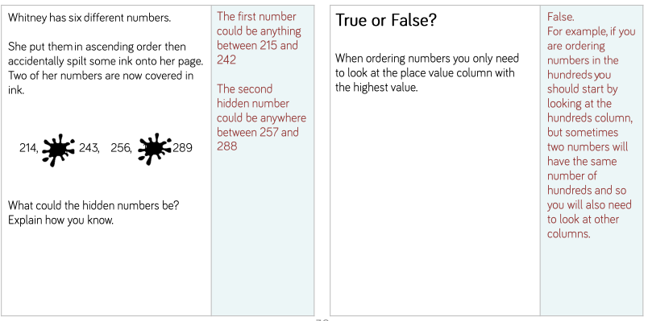
Answers
335
353
355
533
353
356 will go before 355 and after 533.

