Slide 1
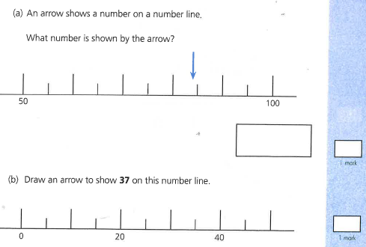

Slide 2
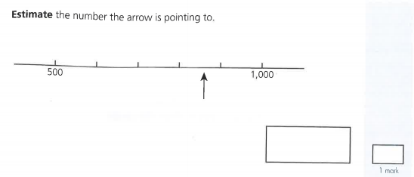

Slide 3
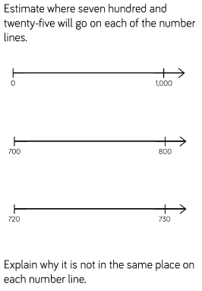

Slide 4
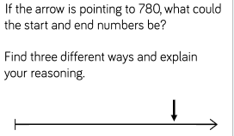

Slide 5
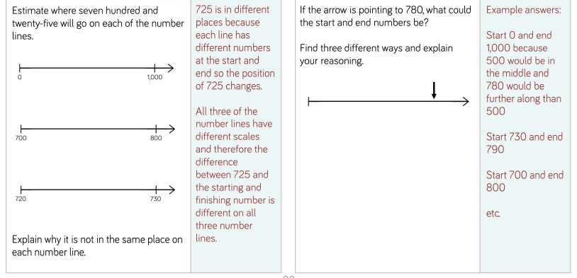
Answers
600
700
800
900
850
It is important the pupil recognises the arrow is past the half-way point between 800 and 900.
60
70
85
860
55
65
80
90
75
84

