Slide 2
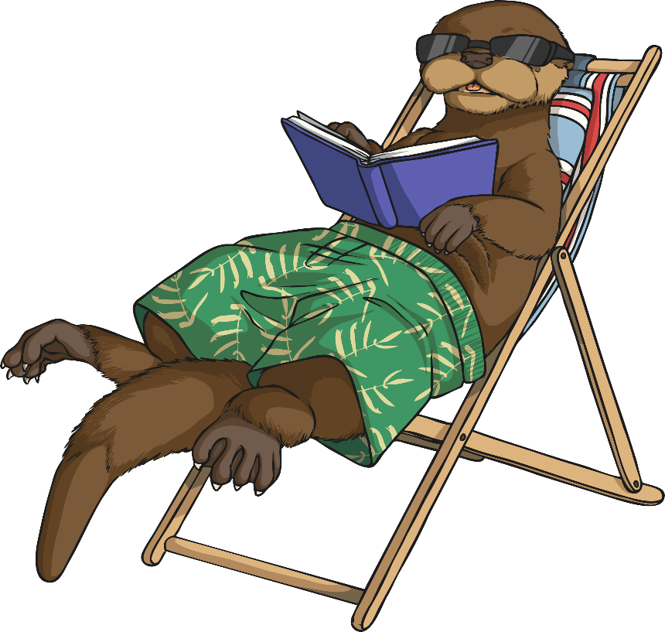
Year 6 Project Pack: Anywhere Island
During this project you will:
develop your problem-solving and creative thinking skills;
make decisions and choices;
use a range of geographical skills;
discuss your opinions on important issues;
let your imagination run wild and;
Have fun!

Slide 3
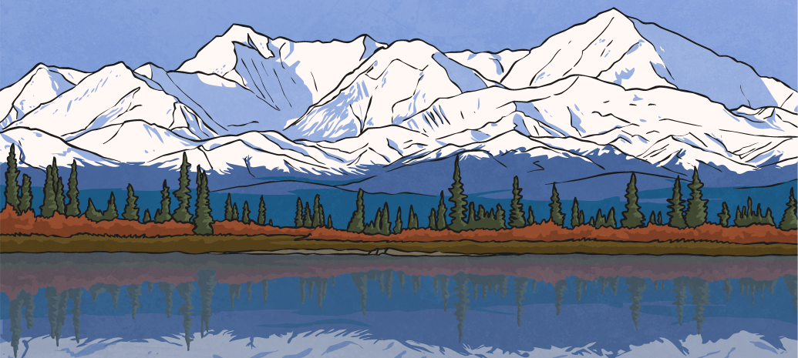
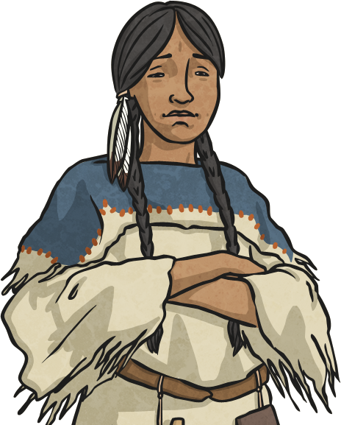
Lesson 3: Creating a National Identity
Every country in the world has its own distinctive traditions, culture and language. Your island currently has no identity, and now’s the time to start creating one.
In this lesson, you will design a national flag and a national anthem.

Slide 4
National Flags
The national flag of a country can often have a deep meaning and hold symbolic significance for the people of a nation.
Let’s test your flag knowledge – can you name the country that these national flags belong to?
Could you guess the meaning behind each one’s colours, symbols or shapes?

Slide 5
The National Flag of…
Do you know which country this flag belongs to?
Do you know the meaning behind it?
Each colour of the Brazilian flag symbolises something very important to Brazilian culture. The yellow represents the country’s gold reserves, the green represents the country’s tropical landscape and the blue is a globe with 27 white stars upon it (one for every district in Brazil).
Across the glove, the banner reads ‘Ordem E Progresso’, which is a Brazilian motto meaning ‘Order and Progress’.
Brazil

Slide 6
The National Flag of…
Do you know which country this flag belongs to?
Do you know the meaning behind it?
The red maple leaf has been the national symbol of Canada for over 150 years. For Canadian people, it is a symbol of unity, tolerance and peace.
Red and white are the official colours of Canada, proclaimed by King George V in 1921.
Canada

Slide 7
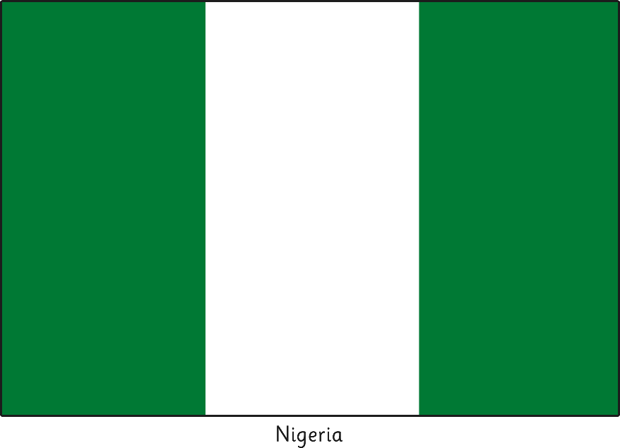
The National Flag of…
Do you know which country this flag belongs to?
Do you know the meaning behind it?
The green stripes of Nigeria’s flag represent their lush vegetation and its agriculture industry (that the Nigerians would call their natural wealth).
While the white stripe represents their desire for peace.
Nigeria

Slide 8
A National Anthem
A national anthem is a patriotic song that is officially adopted by a country as an expression of their national identity.
Do you know the national anthem for the country you live in?

Slide 9
National Anthem Lyrics
Which country are these national anthem lyrics from?
What do you think they mean?
This land of my fathers is dear to me
Land of poets and singers, and people of stature
Her brave warriors, fine patriots
Shed their blood for freedom
Land! Land! I am true to my land!
As long as the sea serves as a wall for this pure, dear land
May the language endure forever.
Old land of the mountains, paradise of the poets,
Every valley, every cliff a beauty guards’
Through love of my country, enchanting voices will be
Her stream and rivers to me.
Wales

Slide 10
Composing Your National Anthem
You now need to think of some national anthem lyrics to symbolise your island.
They could relate to…
your island’s landscape;
your island’s history;
your island’s values or a country motto;
and/or
the person who discovered your island… you!

Slide 11
Your Nation’s Identity

Slide 12
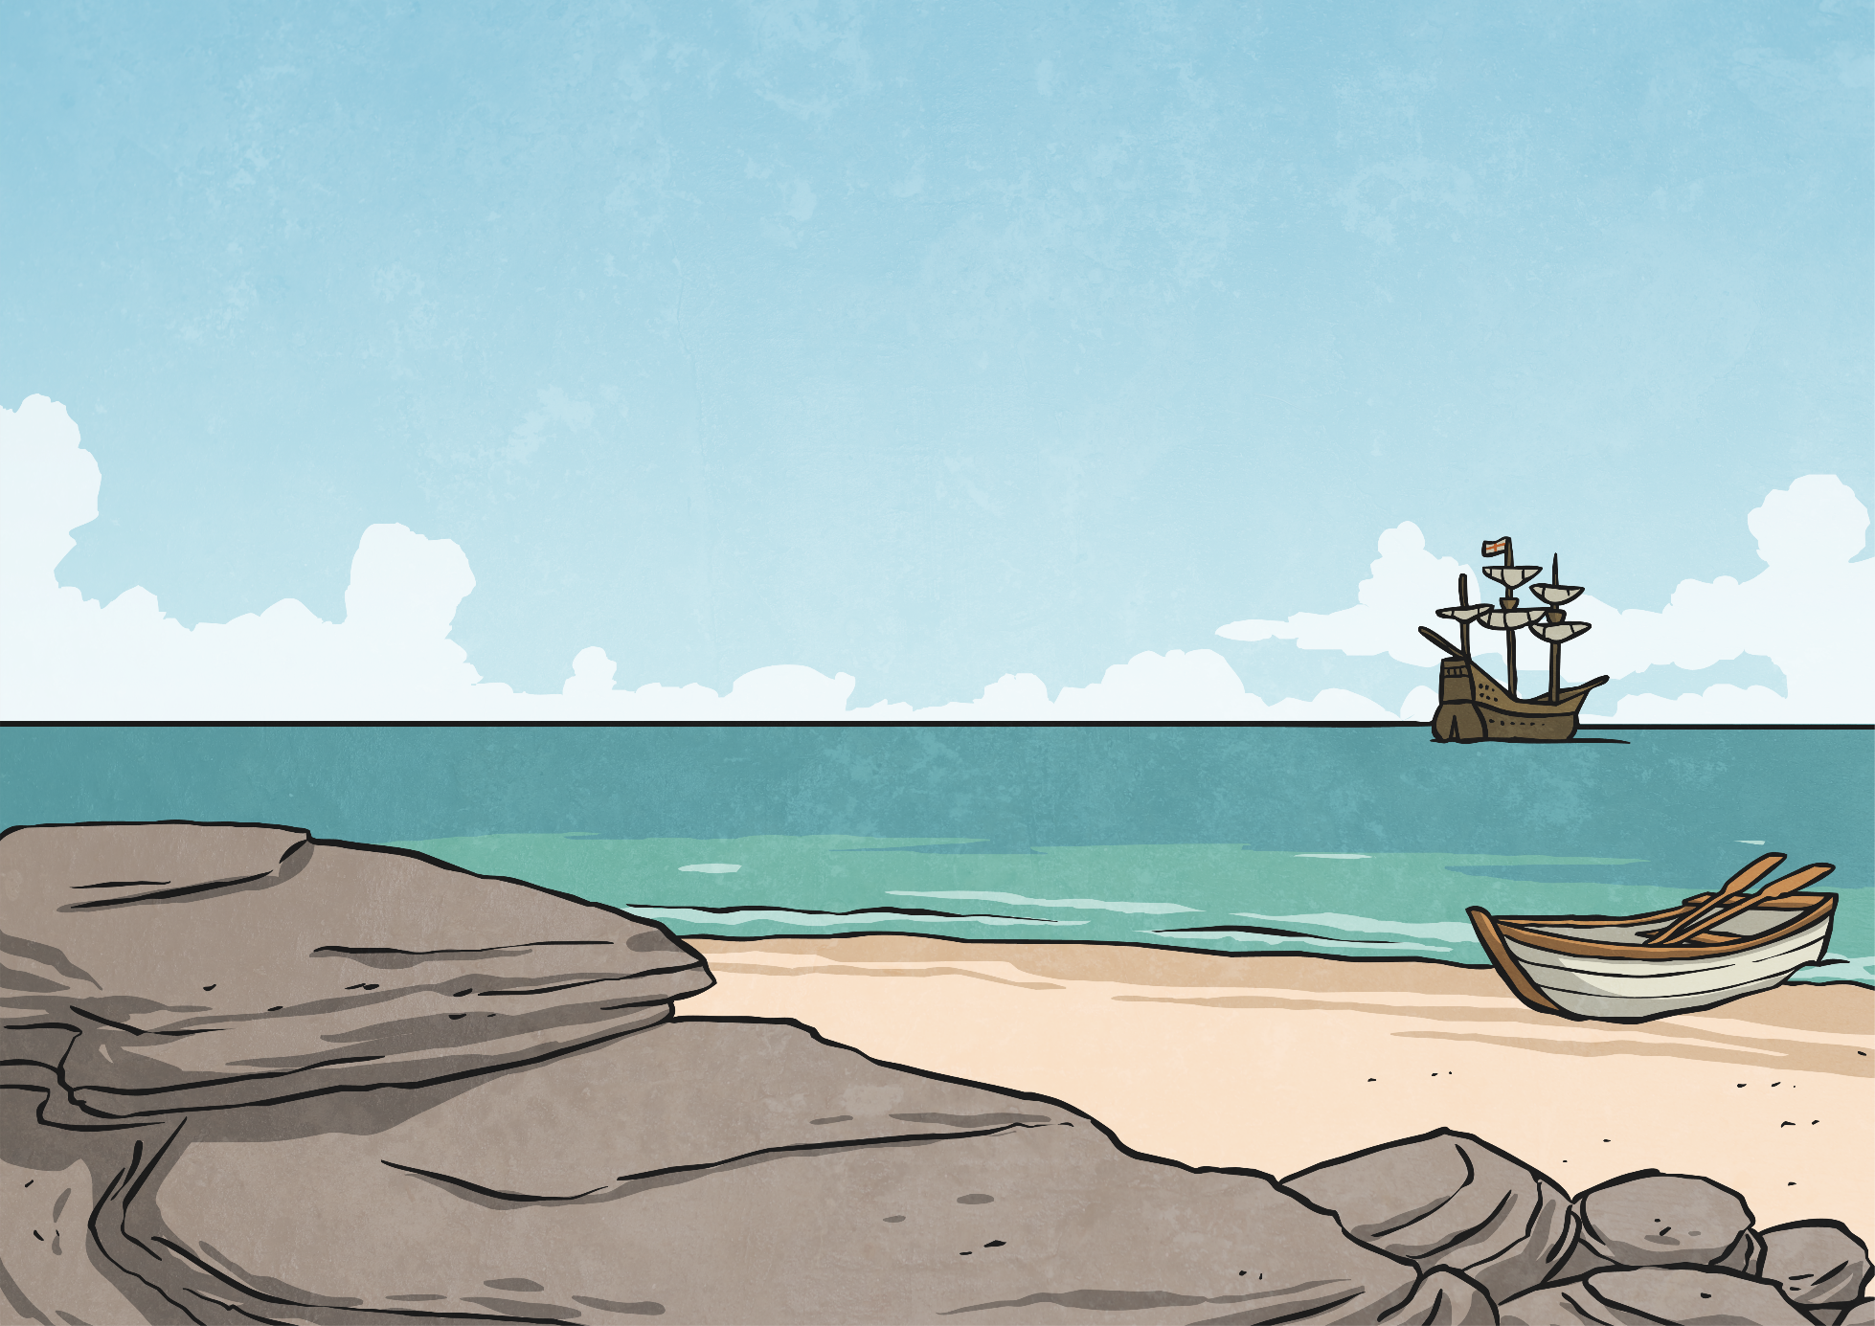
Reflection
Reflection Questions
How did you design your flag? Why?
What do the colours represent on your flag?
Who would like to share their national anthem?
What specific words have you used in your song? Why?

Slide 13
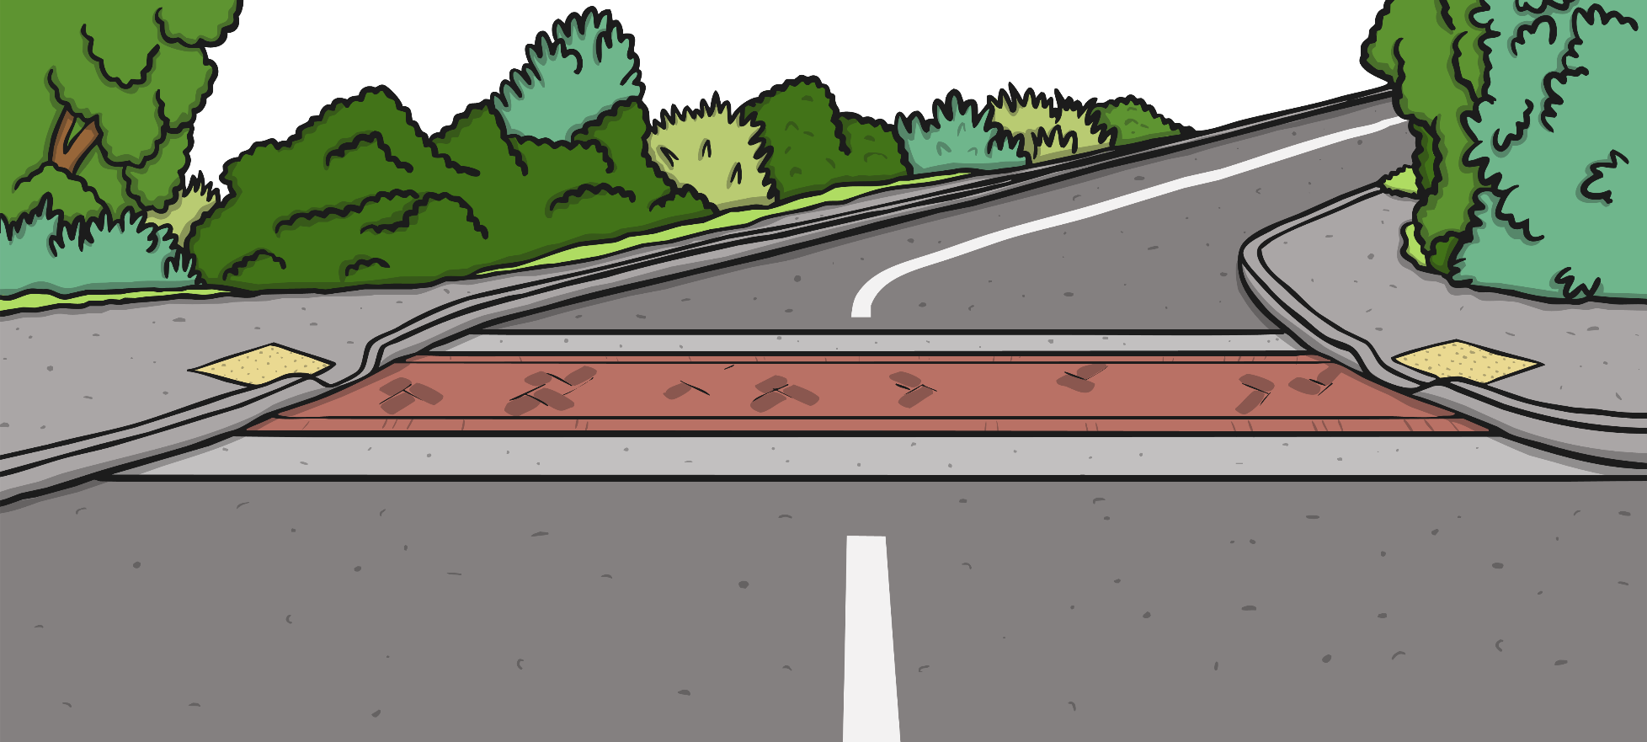
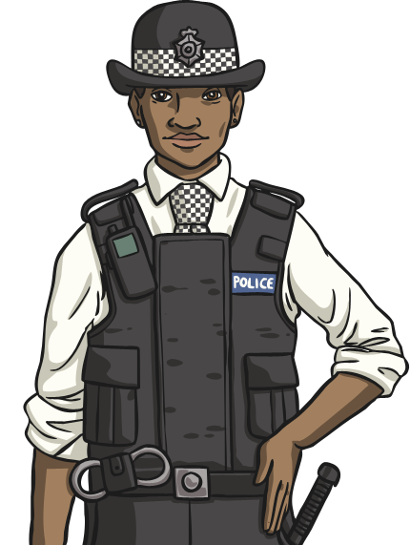
Lesson 4: The Island Rules
Why do countries have rules and laws?
If your island is going to start to have inhabitants who live there, do you need to set some laws for them to live by?

Slide 14
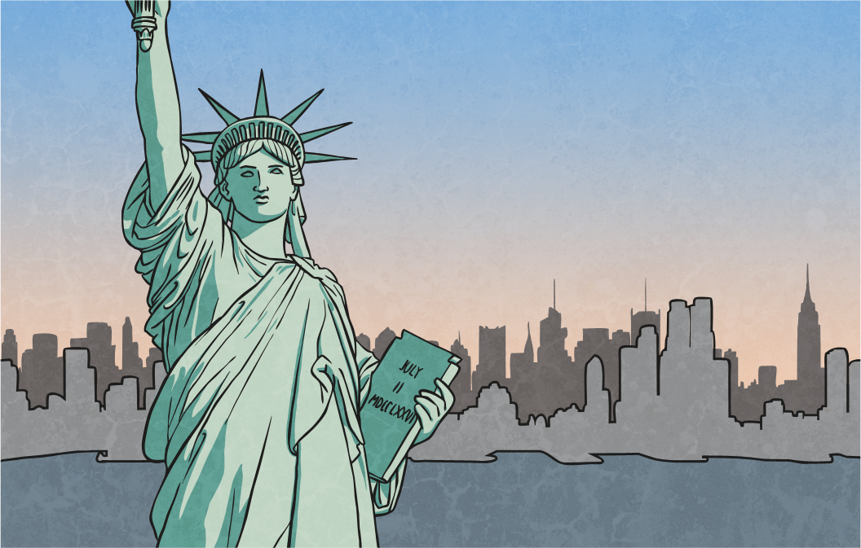
Why Do You Need a Legal System?
There are many reasons why countries need laws. These include:
To prevent anti-social and unacceptable behaviour.
To identify who should rightfully own items and property.
To regulate family and personal relationships e.g. getting married, inheritance etc.
To provide a means for citizens to resolve disputes with other citizens.

Slide 15
Setting the Rules
What rules and laws will your people live by?
Will people have ‘freedom of speech’?
Will there be age restrictions on doing certain activities?
Will children be required to go to school?
How will people be punished for breaking the law?
Will people be allowed to own weapons?

Slide 16
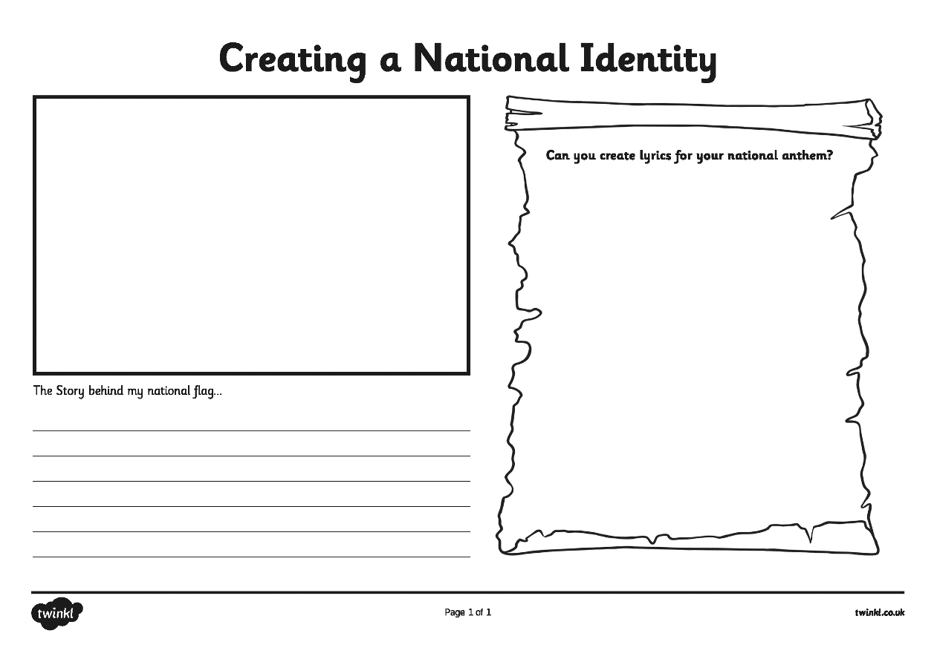
Your Nation’s Identity
Design a poster that gives details of the most important laws on your island.
How will breaking the laws be punished?

Slide 17
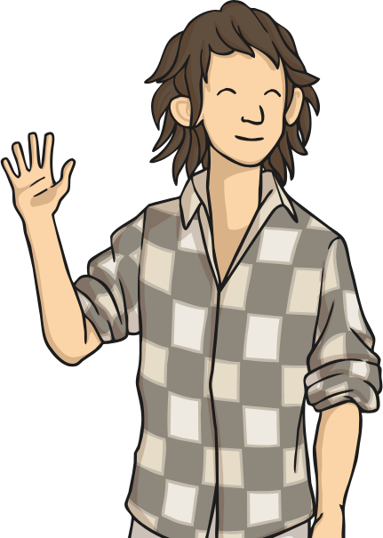
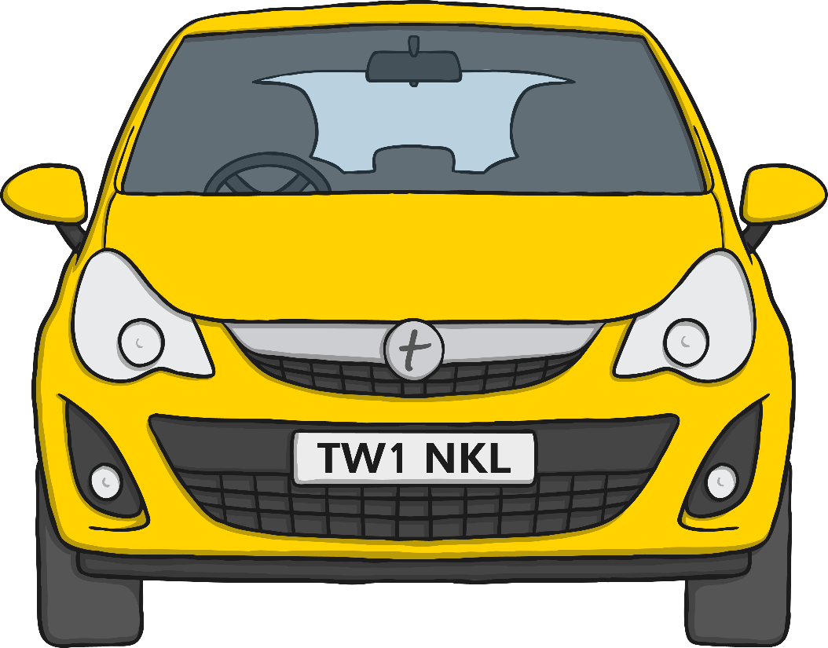
Scenario 1: Are They a Law-Breaker?
Would this person be committing a crime on your island?
How would they be punished?
Danny is just 14 years old.
He has been driving a car on a public road with no one else in the car.

Slide 18
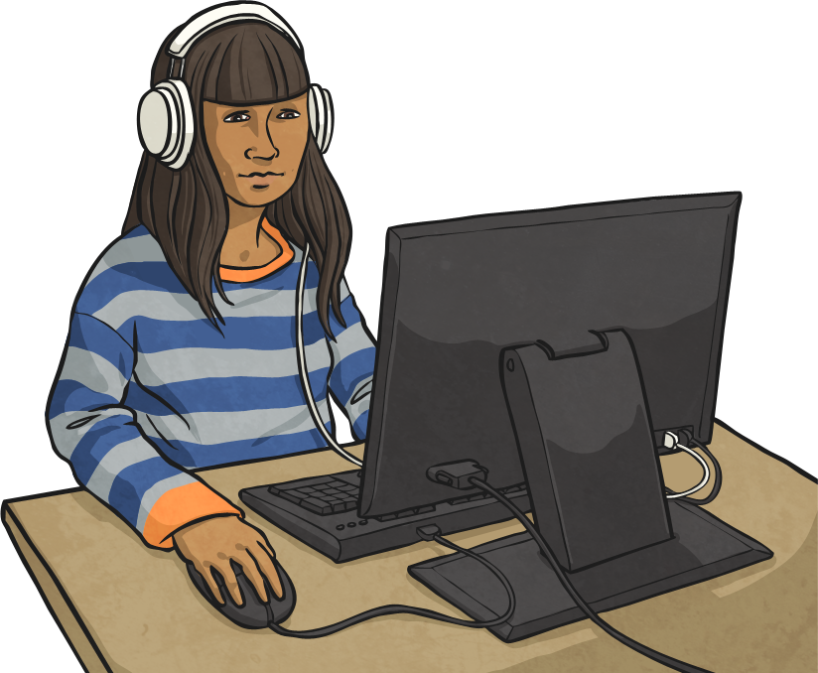
Scenario 2: Are They a Law-Breaker?
Would this person be committing a crime on your island?
How would they be punished?
Sidney posts a malicious and offensive message on a social media site directed at another islander.

Slide 19
Scenario 3: Are They a Law-Breaker?
Would this person be committing a crime on your island?
How would they be punished?
Rita owns a hand gun without a license.
She believes it is her right to protect her family and possessions.

Slide 20
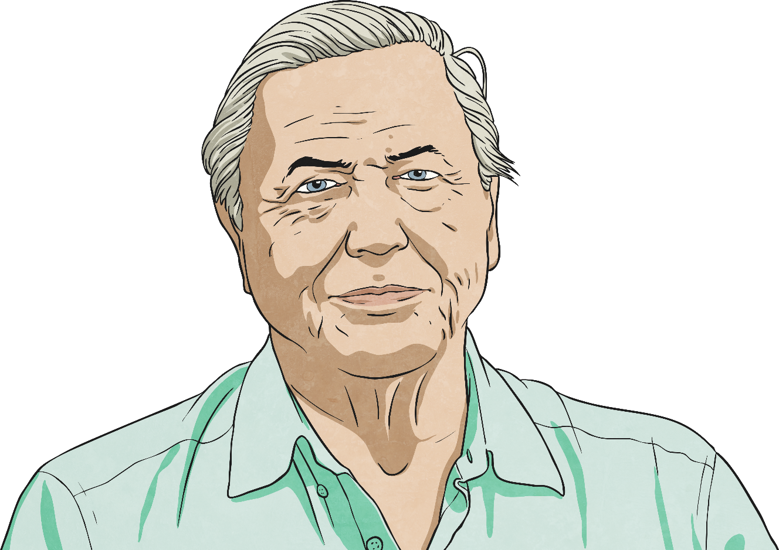
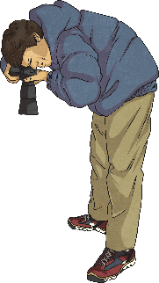
Lesson 5: Stop the Press!
David Attenborough and his Natural World film crew are on their way to your island… a new species of animal has just been found there!

Slide 21
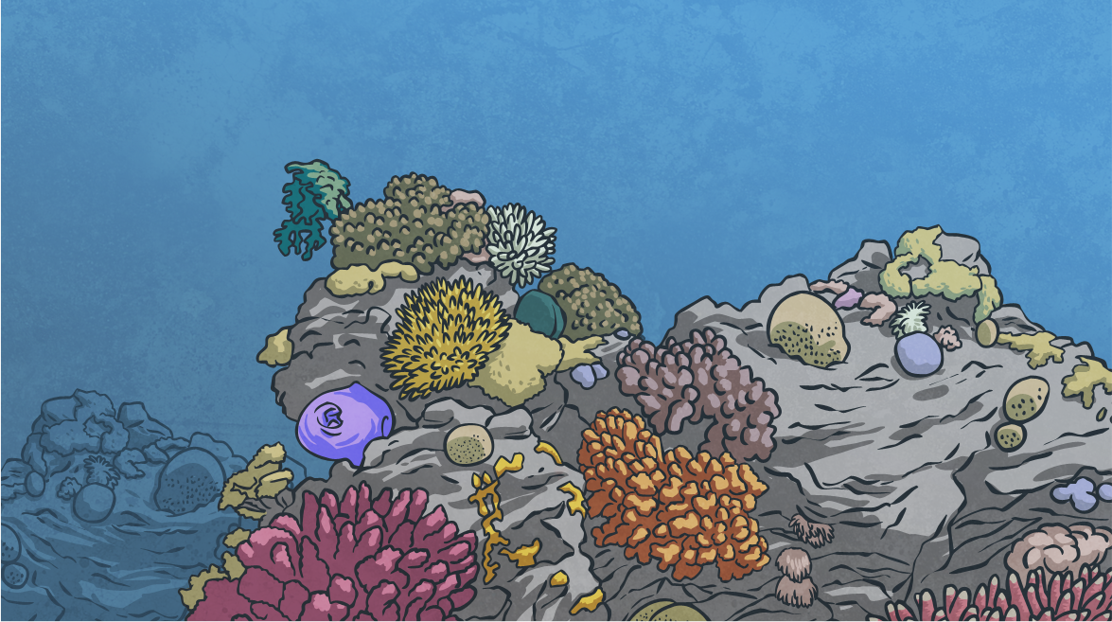
Animal Classification
What is it that has been found?
Is it a vertebrate or invertebrate? Can you remember what these terms mean?
How are vertebrates classified further?

Slide 22
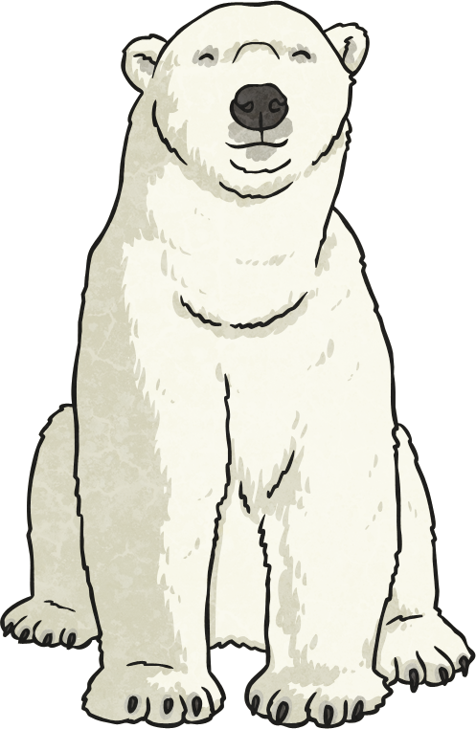
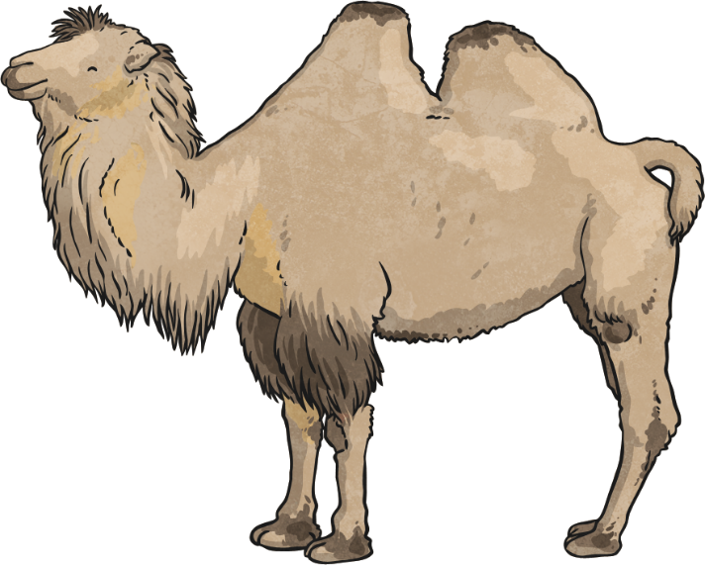
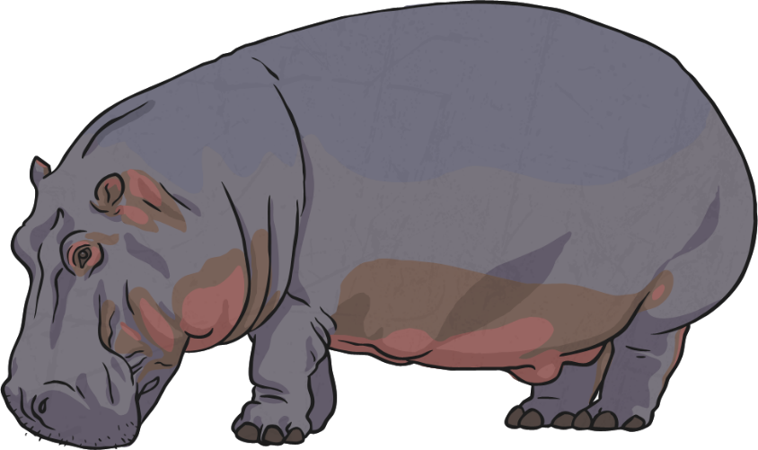
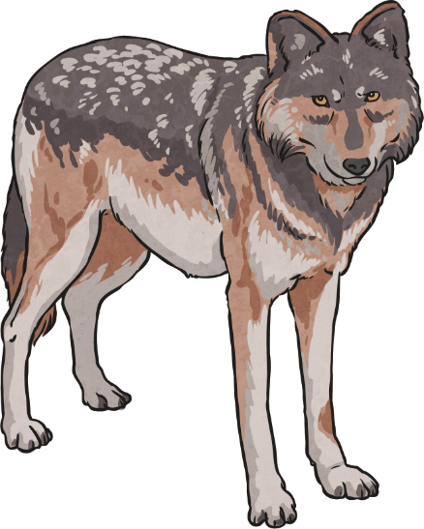
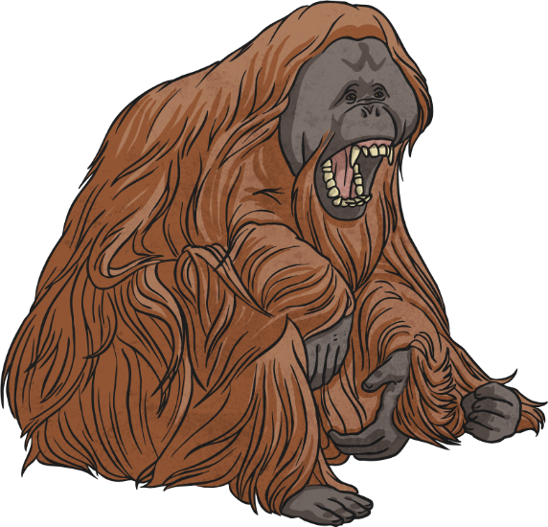
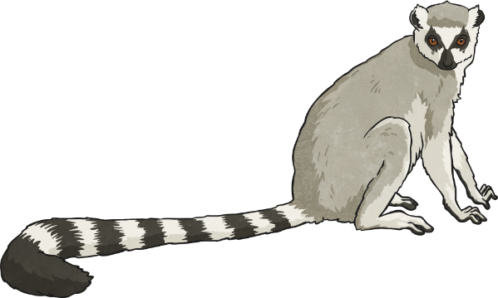
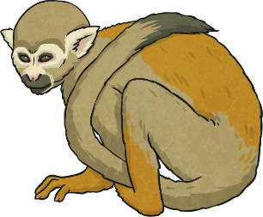
Weird and Wonderful Species
On the next few slides, we’ll look at some of the weirdest species of animal that have been found all over the world…
Do any of them have similar characteristics to the discovery on your island?

Slide 23
Weird and Wonderful Species
Pink Fairy Armadillo
The pink fairy armadillo is the smallest species of armadillo – a mammal with a bony shell armour. They are usually found in the sandy plains, dunes and grasslands of Argentina. The species have small eyes, silky yellowish white fur, and a flexible shell that is solely attached to its body by a thin membrane. This unusual creature is nocturnal and has solitary habits, preferring to live alone. Its diet is mainly composed of insects, worms, snails and various plants.

Slide 24
Weird and Wonderful Species
Axolotl
Axolotls are a type of amphibian salamander. They can only be found in Lake Xochimilco, near Mexico City. Unlike other amphibians, axolotls spend their entire life in the water. This unique-looking animal is listed as critically endangered. Their body can be black, mottled brown, albino (without any pigment) or white. Axolotls look like a tadpole with limbs, a dorsal fin and a pair of gills. Unusually, they do not have eyelids! They are carnivores (meat-eaters) and like to eat molluscs, crustaceans and small fish.

Slide 25
Weird and Wonderful Species
Tarsier
Tarsiers are a type of mammal primate. They have enormous eyes and long feet. Their feet have extremely elongated tarsus bones, which is how they got their name. They are insectivores and catch insects by jumping at them. They are mainly found in the forests of the south-east Asian islands of the Philippines, Malaysia and Indonesia.
All tarsier species are nocturnal and they are extremely shy animals.

Slide 26
Weird and Wonderful Species
Kakapo
The kakapo is a nocturnal parrot that has evolved to be flightless due to the absence of predators in its New Zealand habitat. Due mainly to hunting, it is now almost extinct and survives only on three small, intensively managed islands. Dedicated conservation efforts have seen their population increase slowly to just 125 individual birds on the whole planet. The species are the heaviest parrot in the world and they have a very long life expectancy – living up to 90 years. The kakapo has a herbivorous diet, eating seeds, nuts, fruits, berries and flowers.

Slide 27
Weird and Wonderful Species
Blobfish
Blobfish get their name from their soft fleshly body which lacks muscle or much of a skeleton, making them very floppy when they are taken out of water. They live at such deep depths in the waters off the coasts of Australia and New Zealand (up to 600 and 1200 metres below the water surface) that they don’t have the normal air bladder that most fish use to move up and down. If they did, the air bladder would explode because of the extreme water pressure their bodies incur. Blobfish have very large mouths that they use to catch crustaceans as they sim slowly along the floor of the ocean.

Slide 28
Weird and Wonderful Species
Leaf-Nosed Snake
The leaf-nosed snake is native to the island of Madagascar and is found in deciduous dry forests and rainforests. This species has a long tapering snout hence their name. They are unusually rear-fanged and a bite from one would cause severe pain in humans but would not be deadly. They are known to be an ambush predator as their colouration and body shape, which mimic twigs, give it camouflage. They are carnivores and often eat lizards and frogs.

Slide 29
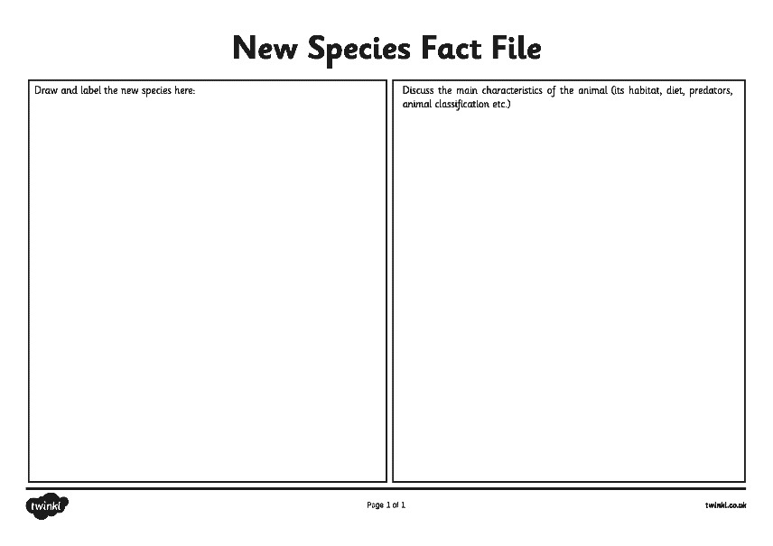
Design Your New Species
Create a fact file for the new species that has been discovered.
Questions
Which animal group does it belong to?
What does its diet consist of?
What are its predators?
What is its natural habitat?
What makes it unique?
What does it look like?
What will you name it?

Slide 30
Reflection
What is your new species called?
What are its main characteristics?

Slide 31
Lesson 6: Developing a Tourism Industry
Now you’ve created your own island, you need people to visit in order to bring money in. This is called developing a ‘tourism industry’.
Questions
Why would tourists want to visit your island?
What unique features does it have?
What sights could they see?
What activities could they participate in?

Slide 32
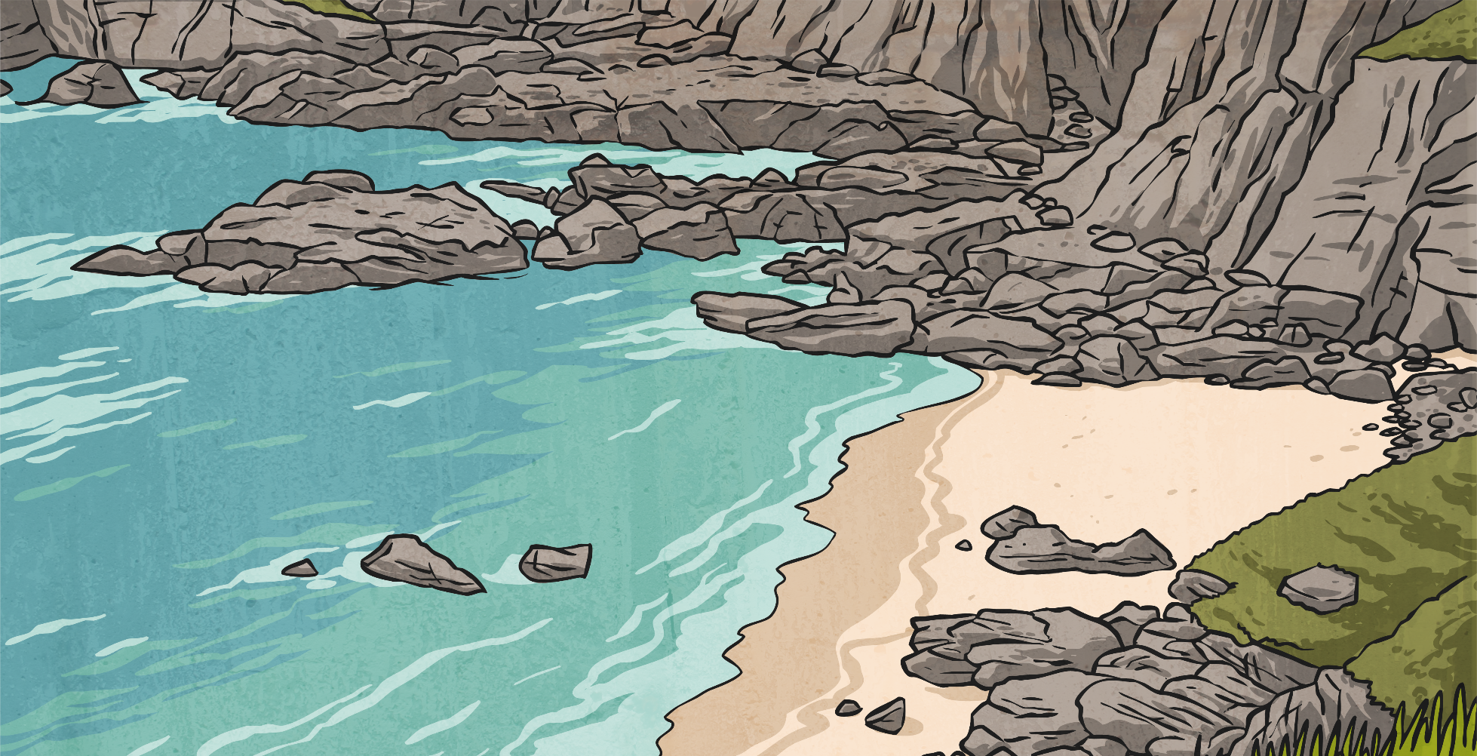
Persuasive Holiday Brochure
Your last job is to create a persuasive holiday brochure to encourage visitors to your island.
What features and persuasive devices can you find in the tourist brochures on your desk?
Discuss them with a partner.

Slide 33
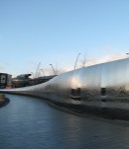
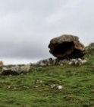
What a Successful Brochure Looks Like…
What features can you spot in this travel brochure?
Beautiful images
Summer in Yorkshire
It’s Cycling Heaven
Rhetorical questions
Exciting/emotive
Are you mad about cycling and looking for something different this summer?
Come to Yorkshire this summer for Le Tour Yorkshire and you will also get beautiful beaches, wild wilderness, magnificent history and stunning cities.
Personal pronouns
Flattering descriptions
York, Leeds and Sheffield
If you love city life, come and stay in one of these great cities and soak up the atmosphere of Le Tour! There are museums, minsters and lots of great shops.
Informal language
Present tense
Repetition
Wild Wilderness
As Le Tour winds its way up through the stunning Yorkshire moorlands, you can camp under the stars at one of the peaceful campsites along the route.
Directive language
Clear presentation

Slide 34
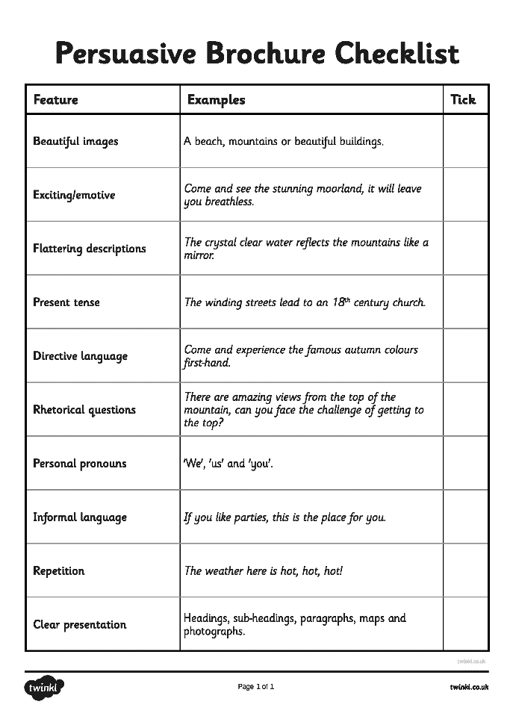
Persuasive Writing Checklist
Use this persuasive writing checklist as you create your brochure.
Tick of the features as you use them.
You may want to use the holiday brochure template or you may wish to design the layout of the brochure yourself.

Slide 35
Have You Produced a Successful Brochure?
Share your brochure with a partner or another adult in school.
Would they be persuaded to visit your island? Why?
What features have you used to convince them?

