Slide 1
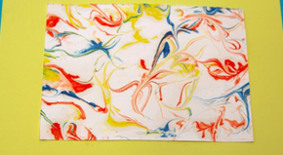
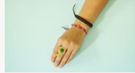
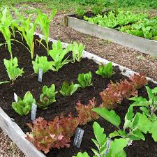
Hello all you fabulous children. I hope the start of Ramadan has been wonderful for you and you are spending this time reflecting on different aspects of your life. Reflection is so important to help us all become better people and think about how we can help others
This is a poem written by a year 4 child. Why don’t you have a go at writing a poem based on your lockdown experience?
Why not create a time capsule of this time and bury it? You can add your reflections on this time, pictures, drawings and a newspaper.
Keep positive and stay strong
Fun Art Activities
Try these art activities at home. I had fun trying them out.
Creating marbled paper
https://www.tate.org.uk/kids/make/paint-draw/make-marbled-paper-foam
Make a friendship bracelet
https://www.tate.org.uk/kids/make/cut-paste/make-friendship-bracelet
New Edition to the IQRA website
Listen to the teachers re-telling a story while you follow the text
I have been reading all your shout outs and it is wonderful to see you have all been keeping busy. Zara in 3.1 gave me an idea. Why not create a patch in your garden? That way you can grow mint, potatoes, strawberries and many other delicious fruit and vegetables
Last but not least create a rainbow to show thanks to the NHS workers and display it in your window.

