Slide 1
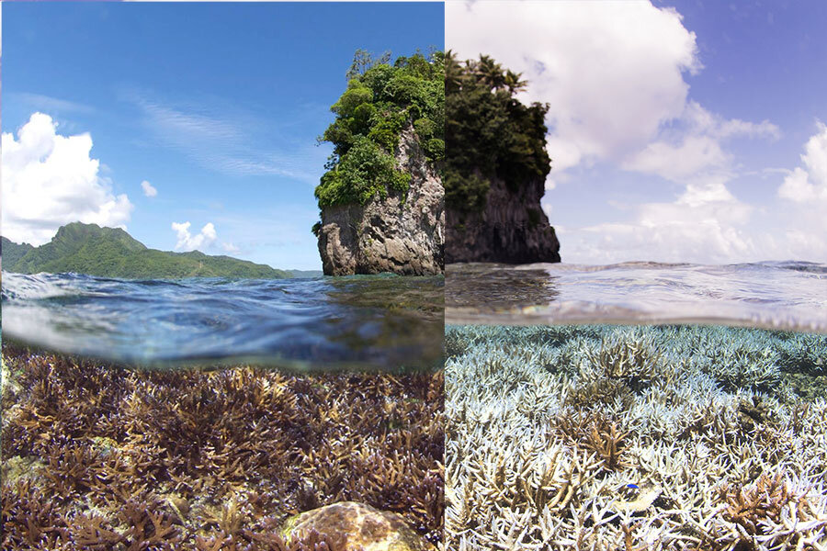
Year 5 – Summer 1 Planning – Investigating the World’s Natural Resources
Cross Curricular: Writing: Non Fiction – Balanced Argument
NC Objectives:
This term the pupils in Year 5 will compose a balanced argument on the motion: ‘Should the UK prioritise the use of renewable resources over non-renewable resources for energy production?’ They will employ the use of grammatical features, such as: expanded noun phrases, conjunctions, fronted adverbials, multiclause sentences, manipulate register through the use of idioms and other figurative language and select the correct verb tenses throughout their compositions. To ensure their compositions are not ambiguous, the use of advanced punctuation, for example, semi-colons and colons, will be prioritised. As well as this, they will utilise organisational features such as an introduction, main body and conclusion, alongside images and captions to convey their key ideas, with cohesion and clarity.
PSHE - NC Objectives: To learn about the importance of money and why it matters:
To understand the role of money in our lives
To identify the ways in which retailers try to influence our spending.
To explore whether items are value for money.
To explore the importance of borrowing money.
To discuss the benefits of tax on society.
Locational knowledge
Locate the world’s countries, using maps to focus on North and South America, concentrating on their environmental regions, key physical and human characteristics, countries, and major cities
Name and locate counties and cities of the United Kingdom, geographical regions and their identifying human and physical characteristics, key topographical features (including hills, mountains, coasts and rivers), and land-use patterns; and understand how some of these aspects have changed over time
Human and physical geography
Describe and understand key aspects of: Climate zones, biomes and vegetation belts, rivers, mountains, volcanoes and earthquakes, and the water cycle; types of settlement and land use, economic activity including trade links, and the distribution of natural resources including energy, food, minerals and water.
Geography: NC Objectives
Science: NC Objectives
In science this term, the children will focus on Earth and Space;
Describe the movement of the Earth, and other planets, relative to the Sun in the solar system
Describe the movement of the Moon relative to the Earth
Describe the Sun, Earth and Moon as approximately spherical bodies
Use the idea of the Earth’s rotation to explain day and night and the apparent movement of the sun across the sky.

